Slide 1
Relations
Chapter 9
Mr. SHOAIB RAZA

Slide 2
Chapter Summary
Relations and Their Properties
Representing Relations
Equivalence Relations

Slide 3
Relations and Their Properties
Section 9.1

Slide 4
Section Summary
Relations and Functions
Properties of Relations
Reflexive Relations
Symmetric and Antisymmetric Relations
Transitive Relations
Combining Relations

Slide 5
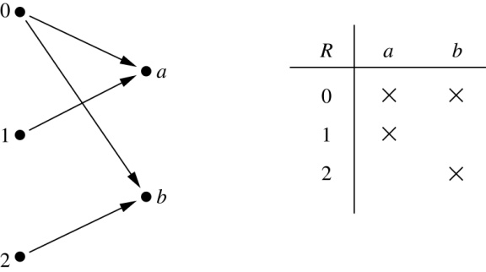
Binary Relations
Definition: A binary relation R from a set A to a set B is a subset R ⊆ A × B.
Example:
Let A = {0,1,2} and B = {a,b}
{(0, a), (0, b), (1,a) , (2, b)} is a relation from A to B.
We can represent relations from a set A to a set B graphically or using a table:
Relations are more general than functions. A function is a relation where exactly one element of B is related to each element of A.

Slide 6
Binary Relation on a Set
Definition: A binary relation R on a set A is a subset of A × A or a relation from A to A.
Example:
Suppose that A = {a,b,c}. Then R = {(a,a),(a,b), (a,c)} is a relation on A.
Let A = {1, 2, 3, 4}. The ordered pairs in the relation R = {(a,b) | a divides b} are
(1,1), (1, 2), (1,3), (1, 4), (2, 2), (2, 4), (3, 3), and (4, 4).

Slide 7
Binary Relation on a Set (cont.)
Question: How many relations are there on a set A?
Solution: Because a relation on A is the same thing as a subset of A ⨉ A, we count the subsets of A × A. Since A × A has n² elements when A has n elements, and a set with m elements has 2^{m} subsets, there are subsets of A × A. Therefore, there are relations on a set A.

Slide 8
Binary Relations on a Set (cont.)
Example: Consider these relations on the set of integers:
R₁ = {(a,b) | a ≤ b}, R₄ = {(a,b) | a = b},
R₂ = {(a,b) | a > b}, R₅ = {(a,b) | a = b + 1},
R₃ = {(a,b) | a = b or a = −b}, R₆ = {(a,b) | a + b ≤ 3}.
Which of these relations contain each of the pairs
(1,1), (1, 2), (2, 1), (1, −1), and (2, 2)?
Solution: Checking the conditions that define each relation, we see that the pair (1,1) is in R₁, R₃, R₄ , and R₆: (1,2) is in R₁ and R₆: (2,1) is in R₂, R₅, and R₆: (1, −1) is in R₂, R₃, and R₆ : (2,2) is in R₁, R₃, and R₄.
Note that these relations are on an infinite set and each of these relations is an infinite set.

Slide 9
Reflexive Relations
Definition: R is reflexive iff (a,a) ∊ R for every element a ∊ A. Written symbolically, R is reflexive if and only if
∀x[x∊U ⟶ (x,x) ∊ R]
Example: The following relations on the integers are reflexive:
R₁ = {(a,b) | a ≤ b},
R₃ = {(a,b) | a = b or a = −b},
R₄ = {(a,b) | a = b}.
The following relations are not reflexive:
R₂ = {(a,b) | a > b} (note that 3 ≯ 3),
R₅ = {(a,b) | a = b + 1} (note that 3 ≠3 + 1),
R₆ = {(a,b) | a + b ≤ 3} (note that 4 + 4 ≰ 3).
If A = ∅ then the empty relation is reflexive vacuously. That is the empty relation on an empty set is reflexive!

Slide 10
Symmetric Relations
Definition: R is symmetric iff (b,a) ∊ R whenever (a,b) ∊ R for all a,b ∊ A. Written symbolically, R is symmetric if and only if
∀x∀y [(x,y) ∊R ⟶ (y,x) ∊ R]
Example: The following relations on the integers are symmetric:
R₃ = {(a,b) | a = b or a = −b},
R₄ = {(a,b) | a = b},
R₆ = {(a,b) | a + b ≤ 3}.
The following are not symmetric:
R₁ = {(a,b) | a ≤ b} (note that 3 ≤ 4, but 4 ≰ 3),
R₂ = {(a,b) | a > b} (note that 4 > 3, but 3 ≯ 4),
R₅ = {(a,b) | a = b + 1} (note that 4 = 3 + 1, but 3 ≠4 + 1).

Slide 11
Antisymmetric Relations
Definition:A relation R on a set A such that for all a,b ∊ A if (a,b) ∊ R and (b,a) ∊ R, then a = b is called antisymmetric. Written symbolically, R is antisymmetric if and only if
∀x∀y [(x,y) ∊R ∧ (y,x) ∊ R ⟶ x = y]
Example: The following relations on the integers are antisymmetric:
R₁ = {(a,b) | a ≤ b},
R₂ = {(a,b) | a > b},
R₄ = {(a,b) | a = b},
R₅ = {(a,b) | a = b + 1}.
The following relations are not antisymmetric:
R₃ = {(a,b) | a = b or a = −b}
(note that both (1,−1) and (−1,1) belong to R₃),
R₆ = {(a,b) | a + b ≤ 3} (note that both (1,2) and (2,1) belong to R₆).
For any integer, if a a ≤ b and a ≤ b , then a = b.

Slide 12
Transitive Relations
Definition: A relation R on a set A is called transitive if whenever (a,b) ∊ R and (b,c) ∊ R, then (a,c) ∊ R, for all a,b,c ∊ A. Written symbolically, R is transitive if and only if
∀x∀y ∀z[(x,y) ∊R ∧ (y,z) ∊ R ⟶ (x,z) ∊ R ]
Example: The following relations on the integers are transitive:
R₁ = {(a,b) | a ≤ b},
R₂ = {(a,b) | a > b},
R₃ = {(a,b) | a = b or a = −b},
R₄ = {(a,b) | a = b}.
The following are not transitive:
R₅ = {(a,b) | a = b + 1} (note that both (3,2) and (4,3) belong to R₅, but not (3,3)),
R₆ = {(a,b) | a + b ≤ 3} (note that both (2,1) and (1,2) belong to R₆, but not (2,2)).
For every integer, a ≤ b
and b ≤ c, then b ≤ c.

Slide 13
Combining Relations
Given two relations R₁ and R₂, we can combine them using basic set operations to form new relations such as R₁ ∪ R₂, R₁ ∩ R₂, R₁ − R₂, and R₂ − R₁.
Example: Let A = {1,2,3} and B = {1,2,3,4}. The relations R₁ = {(1,1),(2,2),(3,3)} and R₂ = {(1,1),(1,2),(1,3),(1,4)} can be combined using basic set operations to form new relations:
R₁ ∪ R₂ ={(1,1),(1,2),(1,3),(1,4),(2,2),(3,3)}
R₁ ∩ R₂ ={(1,1)}
R₁ − R₂ ={(2,2),(3,3)}
R₂ − R₁ ={(1,2),(1,3),(1,4)}

Slide 14
Composition
Definition: Suppose
R₁ is a relation from a set A to a set B.
R₂ is a relation from B to a set C.
Then the composition (or composite) of R₂ with R₁, is a relation from A to C where
if (x,y) is a member of R₁ and (y,z) is a member of R₂, then (x,z) is a member of R₂∘ R₁.

Slide 15
Representing the Composition of a Relation
R₁
R₂
w
m
a
x
n
b
y
o
c
p
z
R₁∘ R₂ = {(b,D),(b,B)}

Slide 16
Representing Relations
Section 9.3

Slide 17
Section Summary
Representing Relations using Matrices
Representing Relations using Digraphs

Slide 18
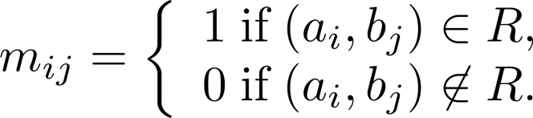
Representing Relations Using Matrices
A relation between finite sets can be represented using a zero-one matrix.
Suppose R is a relation from A = {a₁, a₂, …, a_{m}} to B = {b₁, b₂, …, b_{n}}.
The elements of the two sets can be listed in any particular arbitrary order. When A = B, we use the same ordering.
The relation R is represented by the matrix M_{R} = [m_{ij}], where
The matrix representing R has a 1 as its (i,j) entry when a_{i} is related to b_{j} and a 0 if a_{i} is not related to b_{j}.

Slide 19
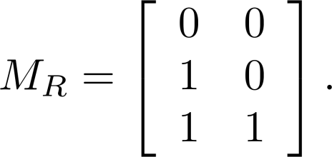
Examples of Representing Relations Using Matrices
Example 1: Suppose that A = {1,2,3} and B = {1,2}. Let R be the relation from A to B containing (a,b) if a ∈ A, b ∈ B, and a > b. What is the matrix representing R (assuming the ordering of elements is the same as the increasing numerical order)?
Solution: Because R = {(2,1), (3,1),(3,2)}, the matrix is

Slide 20
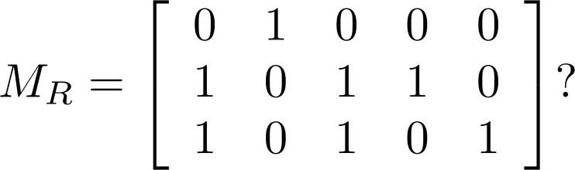
Examples of Representing Relations Using Matrices (cont.)
Example 2: Let A = {a₁,a₂, a₃} and B = {b₁,b₂, b₃,b₄, b₅}. Which ordered pairs are in the relation R represented by the matrix
Solution: Because R consists of those ordered pairs (a_{i},b_{j}) with m_{ij} = 1, it follows that:
R = {(a₁, b₂), (a₂, b₁),(a₂, b₃), (a₂, b₄),(a₃, b₁), {(a₃, b₃), (a₃, b₅)}.

Slide 21
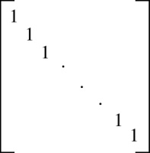
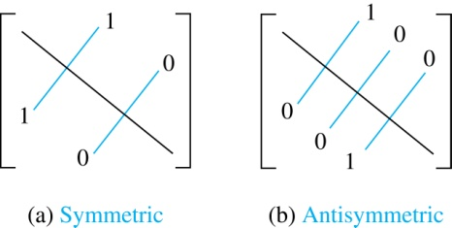
Matrices of Relations on Sets
If R is a reflexive relation, all the elements on the main diagonal of M_{R} are equal to 1.
R is a symmetric relation, if and only if m_{ij} = 1 whenever m_{ji} = 1. R is an antisymmetric relation, if and only if m_{ij} = 0 or m_{ji} = 0 when i≠ j.

Slide 22
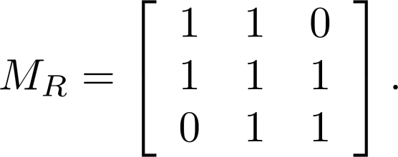
Example of a Relation on a Set
Example 3: Suppose that the relation R on a set is represented by the matrix
Is R reflexive, symmetric, and/or antisymmetric?
Solution: Because all the diagonal elements are equal to 1, R is reflexive. Because M_{R} is symmetric, R is symmetric and not antisymmetric because both m_{1,2} and m_{2,1} are 1.

Slide 23
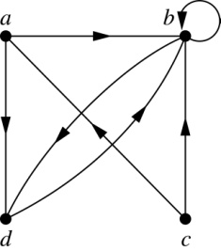
Representing Relations Using Digraphs
Definition: A directed graph, or digraph, consists of a set V of vertices (or nodes) together with a set E of ordered pairs of elements of V called edges (or arcs). The vertex a is called the initial vertex of the edge (a,b), and the vertex b is called the terminal vertex of this edge.
An edge of the form (a,a) is called a loop.
Example 7: A drawing of the directed graph with vertices a, b, c, and d, and edges (a, b), (a, d), (b, b), (b, d), (c, a), (c, b), and (d, b) is shown here.

Slide 24
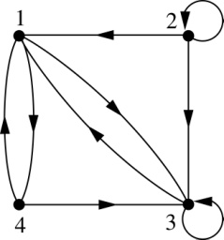
Examples of Digraphs Representing Relations
Example 8: What are the ordered pairs in the relation
represented by this directed graph?
Solution: The ordered pairs in the relation are
(1, 3), (1, 4), (2, 1), (2, 2), (2, 3), (3, 1), (3, 3), (4, 1), and (4, 3)

Slide 25
Determining which Properties a Relation has from its Digraph
Reflexivity: A loop must be present at all vertices in the graph.
Symmetry: If (x,y) is an edge, then so is (y,x).
Antisymmetry: If (x,y) with x ≠ y is an edge, then (y,x) is not an edge.
Transitivity: If (x,y) and (y,z) are edges, then so is (x,z).

Slide 26
Determining which Properties a Relation has from its Digraph – Example 1
a
b
c
d
Reflexive? No, not every vertex has a loop
Symmetric? Yes (trivially), there is no edge from one vertex to another
Antisymmetric? Yes (trivially), there is no edge from one vertex
to another
Transitive? Yes, (trivially) since there is no edge from one vertex to another

Slide 27
Determining which Properties a Relation has from its Digraph – Example 2
a
b
c
d
Reflexive? No, there are no loops
Symmetric? No, there is an edge from a to b, but not from b to a
Antisymmetric? No, there is an edge from d to b and b to d
Transitive? No, there are edges from a to c and from c to b,
but there is no edge from a to d

Slide 28
Determining which Properties a Relation has from its Digraph – Example 3
a
b
c
d
Reflexive? No, there are no loops
Symmetric? No, for example, there is no edge from c to a
Antisymmetric? Yes, whenever there is an edge from one
vertex to another, there is not one going back
Transitive? yes, there is an edge from a to c and c to b than a to b.

Slide 29
Determining which Properties a Relation has from its Digraph – Example 4
b
a
c
d
Reflexive? No, there are no loops
Symmetric? No, for example, there is no edge from d to a
Antisymmetric? Yes, whenever there is an edge from one vertex
to another, there is not one going back
Transitive? Yes (trivially), there are no two edges where the first
edge ends at the vertex where the second edge begins

Slide 30
Example of the Powers of a Relation
b
a
b
a
d
c
d
c
R
R²
a
b
a
b
d
c
d
c
R⁴
R³
The pair (x,y) is in R^{n} if there is a path of length n from x to y in R
(following the direction of the arrows).

Slide 31
Equivalence Relations
Section 9.5

Slide 32
Equivalence Relations
Definition 1: A relation on a set A is called an equivalence relation if it is reflexive, symmetric, and transitive.
Definition 2: Two elements a, and b that are related by an equivalence relation are called equivalent. The notation a ∼ b is often used to denote that a and b are equivalent elements with respect to a particular equivalence relation.

Slide 33
Strings
Example: Suppose that R is the relation on the set of strings of English letters such that aRb if and only if l(a) = l(b), where l(x) is the length of the string x. Is R an equivalence relation?
Solution: Show that all of the properties of an equivalence relation hold.
Reflexivity: Because l(a) = l(a), it follows that aRa for all strings a.
Symmetry: Suppose that aRb. Since l(a) = l(b), l(b) = l(a) also holds and bRa.
Transitivity: Suppose that aRb and bRc. Since l(a) = l(b),and l(b) = l(c), l(a) = l(a) also holds and aRc.

Slide 34
Congruence Modulo m
Example: Let m be an integer with m > 1. Show that the relation
R = {(a,b) | a ≡ b (mod m)}
is an equivalence relation on the set of integers.
Solution: Recall that a ≡ b (mod m) if and only if m divides a − b.
Reflexivity: a ≡ a (mod m) since a − a = 0 is divisible by m since 0 = 0 ∙ m.
Symmetry: Suppose that a ≡ b (mod m). Then a − b is divisible by m, and so a − b = km, where k is an integer. It follows that b − a = (− k) m, so b ≡ a (mod m).
Transitivity: Suppose that a ≡ b (mod m) and b ≡ c (mod m). Then m divides both a − b and b − c. Hence, there are integers k and l with a − b = km and b − c = lm. We obtain by adding the equations:
a − c = (a − b) + (b − c) = km + lm = (k + l) m.
Therefore, a ≡ c (mod m).

Slide 35
Divides
Example: Show that the “divides” relation on the set of positive integers is not an equivalence relation.
Solution: The properties of reflexivity, and transitivity do hold, but there relation is not transitive. Hence, “divides” is not an equivalence relation.
Reflexivity: a ∣ a for all a.
Not Symmetric: For example, 2 ∣ 4, but 4 ∤ 2. Hence, the relation is not symmetric.
Transitivity: Suppose that a divides b and b divides c. Then there are positive integers k and l such that b = ak and c = bl. Hence, c = a(kl), so a divides c. Therefore, the relation is transitive.

Slide 36
Number Theory and Cryptography
Chapter 4

Slide 37
Chapter Motivation
Number theory is the part of mathematics devoted to the study of the integers and their properties.
Key ideas in number theory include divisibility and the primality of integers.
Number theory has long been studied because of the beauty of its ideas, its accessibility, and its wealth of open questions.
We’ll use many ideas developed in Chapter 1 about proof methods and proof strategy in our exploration of number theory.
Mathematicians have long considered number theory to be pure mathematics, but it has important applications to computer science and cryptography studied in Sections 4.5 and 4.6.

Slide 38
Chapter Summary
Divisibility and Modular Arithmetic
Primes and Greatest Common Divisors
Solving Congruencies
Applications of Congruencies
Cryptography

Slide 39
Divisibility and Modular Arithmetic
Section 4.1

Slide 40
Section Summary
Division
Division Algorithm
Modular Arithmetic

Slide 41
Division
Definition: If a and b are integers with a ≠ 0, then a divides b if there exists an integer c such that b = ac.
When a divides b we say that a is a factor or divisor of b and that b is a multiple of a.
The notation a | b denotes that a divides b.
If a | b, then b/a is an integer.
If a does not divide b, we write a ∤ b.
Example: Determine whether 3 | 7 and whether 3 | 12.

Slide 42
Properties of Divisibility
Theorem 1: Let a, b, and c be integers, where a ≠0.
If a | b and a | c, then a | (b + c);
If a | b, then a | bc for all integers c;
If a | b and b | c, then a | c.
Proof: (i) Suppose a | b and a | c, then it follows that there are integers s and t with b = as and c = at. Hence,
b + c = as + at = a(s + t). Hence, a | (b + c)
(Exercises 3 and 4 ask for proofs of parts (ii) and (iii).) Corollary: If a, b, and c be integers, where a ≠0, such that a | b and a | c, then a | mb + nc whenever m and n are integers.
Can you show how it follows easily from from (ii) and (i) of Theorem 1?

Slide 43
Division Algorithm
When an integer is divided by a positive integer, there is a quotient and a remainder. This is traditionally called the “Division Algorithm,” but is really a theorem.
Division Algorithm: If a is an integer and d a positive integer, then there are unique integers q and r, with 0 ≤ r < d, such that a = dq + r (proved in Section 5.2).
d is called the divisor.
a is called the dividend.
q is called the quotient.
r is called the remainder.
Examples:
What are the quotient and remainder when 101 is divided by 11?
Solution: The quotient when 101 is divided by 11 is 9 = 101 div 11, and the remainder is 2 = 101 mod 11.
What are the quotient and remainder when −11 is divided by 3?
Solution: The quotient when −11 is divided by 3 is −4 = −11 div 3, and the remainder is 1 = −11 mod 3.
Definitions of Functions div and mod
q = a div d
r = a mod d

Slide 44
Congruence Relation
Definition: If a and b are integers and m is a positive integer, then a is congruent to b modulo m if m divides a – b.
The notation a ≡ b (mod m) says that a is congruent to b modulo m.
We say that a ≡ b (mod m) is a congruence and that m is its modulus.
Two integers are congruent mod m if and only if they have the same remainder when divided by m.
If a is not congruent to b modulo m, we write
a ≢ b (mod m)
Example: Determine whether 17 is congruent to 5 modulo 6 and whether 24 and 14 are congruent modulo 6.
Solution:
17 ≡ 5 (mod 6) because 6 divides 17 − 5 = 12.
24 ≢ 14 (mod 6) since 6 divides 24 − 14 = 10 is not divisible by 6.

Slide 45
More on Congruences
Theorem 4: Let m be a positive integer. The integers a and b are congruent modulo m if and only if there is an integer k such that a = b + km.
Proof:
If a ≡ b (mod m), then (by the definition of congruence) m | a – b. Hence, there is an integer k such that a – b = km and equivalently a = b + km.
Conversely, if there is an integer k such that a = b + km, then km = a – b. Hence, m | a – b and a ≡ b (mod m).

Slide 46
The Relationship between (mod m) and mod m Notations
The use of “mod” in a ≡ b (mod m) and a mod m = b are different.
a ≡ b (mod m) is a relation on the set of integers.
In a mod m = b, the notation mod denotes a function.
The relationship between these notations is made clear in this theorem.
Theorem 3: Let a and b be integers, and let m be a positive integer. Then a ≡ b (mod m) if and only if a mod m = b mod m. (Proof in the exercises)

Slide 47
Congruencies of Sums and Products
Let m be a positive integer. If a ≡ b (mod m) and c ≡ d (mod m), then
a + c ≡ b + d (mod m) and ac ≡ bd (mod m)
Example: Because 7 ≡ 2 (mod 5) and 11 ≡ 1 (mod 5) , it follows from Theorem 5 that
18 = 7 + 11 ≡ 2 + 1 = 3 (mod 5)
77 = 7 11 ≡ 2 + 1 = 3 (mod 5)

Slide 48
Algebraic Manipulation of Congruencies
Multiplying both sides of a valid congruence by an integer preserves validity.
If a ≡ b (mod m) holds then c∙a ≡ c∙b (mod m), where c is any integer, holds by Theorem 5 with d = c.
Adding an integer to both sides of a valid congruence preserves validity.
If a ≡ b (mod m) holds then c + a ≡ c + b (mod m), where c is any integer, holds by Theorem 5 with d = c.
Dividing a congruence by an integer does not always produce a valid congruence.
Example: The congruence 14≡ 8 (mod 6) holds. But dividing both sides by 2 does not produce a valid congruence since 14/2 = 7 and 8/2 = 4, but 7≢4 (mod 6).

Slide 49
Computing the mod m Function of Products and Sums
We use the following corollary to Theorem 5 to compute the remainder of the product or sum of two integers when divided by m from the remainders when each is divided by m.
Corollary: Let m be a positive integer and let a and b be integers. Then
(a + b) (mod m) = ((a mod m) + (b mod m)) mod m
and
ab mod m = ((a mod m) (b mod m)) mod m.
(proof in text)

Slide 50
Applications of Congruences

Slide 51
Section Summary
Hashing Functions
Pseudorandom Numbers
Check Digits

Slide 52
Hashing Functions
Definition: A hashing function h assigns memory location h(k) to the record that has k as its key.
A common hashing function is h(k) = k mod m, where m is the number of memory locations.
Because this hashing function is onto, all memory locations are possible.
Example: Let h(k) = k mod 111. This hashing function assigns the records of customers with social security numbers as keys to memory locations in the following manner:
h(064212848) = 064212848 mod 111 = 14
h(037149212) = 037149212 mod 111 = 65
h(107405723) = 107405723 mod 111 = 14, but since location 14 is already occupied, the record is assigned to the next available position, which is 15.
The hashing function is not one-to-one as there are many more possible keys than memory locations. When more than one record is assigned to the same location, we say a collision occurs. Here a collision has been resolved by assigning the record to the first free location.
For collision resolution, we can use a linear probing function:
h(k,i) = (h(k) + i) mod m, where i runs from 0 to m − 1.
There are many other methods of handling with collisions. You may cover these in a
later CS course.

Slide 53
Pseudorandom Numbers
Randomly chosen numbers are needed for many purposes, including computer simulations.
Pseudorandom numbers are not truly random since they are generated by systematic methods.
The linear congruential method is one commonly used procedure for generating pseudorandom numbers.
Four integers are needed: the modulus m, the multiplier a, the increment c, and seed x₀, with 2 ≤ a < m, 0 ≤ c < m, 0 ≤ x₀ < m.
We generate a sequence of pseudorandom numbers {x_{n}}, with 0 ≤ x_{n} < m for all n, by successively using the recursively defined function
(an example of a recursive definition, discussed in Section 5.3)
If psudorandom numbers between 0 and 1 are needed, then the generated numbers are divided by the modulus, x_{n} /m.
x_{n+1} = (ax_{n} + c) mod m.

Slide 54
Pseudorandom Numbers
Example: Find the sequence of pseudorandom numbers generated by the linear congruential method with modulus m = 9, multiplier a = 7, increment c = 4, and seed x₀ = 3.
Solution: Compute the terms of the sequence by successively using the congruence x_{n+1} = (7x_{n} + 4) mod 9, with x₀ = 3.
x₁ = 7x₀ + 4 mod 9 = 7∙3 + 4 mod 9 = 25 mod 9 = 7,
x₂ = 7x₁ + 4 mod 9 = 7∙7 + 4 mod 9 = 53 mod 9 = 8,
x₃ = 7x₂ + 4 mod 9 = 7∙8 + 4 mod 9 = 60 mod 9 = 6,
x₄ = 7x₃ + 4 mod 9 = 7∙6 + 4 mod 9 = 46 mod 9 = 1,
x₅ = 7x₄ + 4 mod 9 = 7∙1 + 4 mod 9 = 11 mod 9 = 2,
x₆ = 7x₅ + 4 mod 9 = 7∙2 + 4 mod 9 = 18 mod 9 = 0,
x₇ = 7x₆ + 4 mod 9 = 7∙0 + 4 mod 9 = 4 mod 9 = 4,
x₈ = 7x₇ + 4 mod 9 = 7∙4 + 4 mod 9 = 32 mod 9 = 5,
x₉ = 7x₈ + 4 mod 9 = 7∙5 + 4 mod 9 = 39 mod 9 = 3.
The sequence generated is 3,7,8,6,1,2,0,4,5,3,7,8,6,1,2,0,4,5,3,…
It repeats after generating 9 terms.
Commonly, computers use a linear congruential generator with increment c = 0. This is called a pure multiplicative generator. Such a generator with modulus 2³¹ − 1 and multiplier 7⁵ = 16,807 generates 2³¹ − 2 numbers before repeating.

Slide 55
Check Digits: UPCs
A common method of detecting errors in strings of digits is to add an extra digit at the end, which is evaluated using a function. If the final digit is not correct, then the string is assumed not to be correct.
Example: Retail products are identified by their Universal Product Codes (UPCs). Usually these have 12 decimal digits, the last one being the check digit. The check digit is determined by the congruence:
3x₁ + x₂ + 3x₃ + x₄ + 3x₅ + x₆ + 3x₇ + x₈ + 3x₉ + x₁₀ + 3x₁₁ + x₁₂ ≡ 0 (mod 10).
Suppose that the first 11 digits of the UPC are 79357343104. What is the check digit?
Is 041331021641 a valid UPC?
Solution:
3∙7 + 9 + 3∙3 + 5 + 3∙7 + 3 + 3∙4 + 3 + 3∙1 + 0 + 3∙4 + x₁₂ ≡ 0 (mod 10)
21 + 9 + 9 + 5 + 21 + 3 + 12+ 3 + 3 + 0 + 12 + x₁₂ ≡ 0 (mod 10)
98 + x₁₂ ≡ 0 (mod 10)
x₁₂ ≡ 0 (mod 10) So, the check digit is 2.
3∙0 + 4 + 3∙1 + 3 + 3∙3 + 1 + 3∙0 + 2 + 3∙1 + 6 + 3∙4 + 1 ≡ 0 (mod 10)
0 + 4 + 3 + 3 + 9 + 1 + 0+ 2 + 3 + 6 + 12 + 1 = 44 ≡ 4 ≢ (mod 10)
Hence, 041331021641 is not a valid UPC.

Slide 56
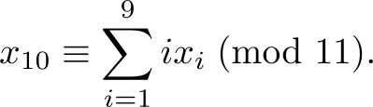

Check Digits:ISBNs
Books are identified by an International Standard Book Number (ISBN-10), a 10 digit code. The first 9 digits identify the language, the publisher, and the book. The tenth digit is a check digit, which is determined by the following congruence
The validity of an ISBN-10 number can be evaluated with the equivalent
Suppose that the first 9 digits of the ISBN-10 are 007288008. What is the check digit?
Is 084930149X a valid ISBN10?
Solution:
a. X₁₀ ≡ 1∙0 + 2∙0 + 3∙7 + 4∙2 + 5∙8 + 6∙8 + 7∙ 0 + 8∙0 + 9∙8 (mod 11).
X₁₀ ≡ 0 + 0 + 21 + 8 + 40 + 48 + 0 + 0 + 72 (mod 11).
X₁₀ ≡ 189 ≡ 2 (mod 11). Hence, X₁₀ = 2.
b. 1∙0 + 2∙8 + 3∙4 + 4∙9 + 5∙3 + 6∙0 + 7∙ 1 + 8∙4 + 9∙9 + 10∙10 =
0 + 16 + 12 + 36 + 15 + 0 + 7 + 32 + 81 + 100 = 299 ≡ 2 ≢ 0 (mod 11)
Hence, 084930149X is not a valid ISBN-10.
A single error is an error in one digit of an identification number and a transposition error is the accidental interchanging of two digits. Both of these kinds of errors can be detected by the check digit for ISBN-10. (see text for more details)
X is used for the digit 10.

Slide 57
Cryptography

Slide 58
Section Summary
Classical Cryptography
Cryptosystems
Public Key Cryptography
RSA Cryptosystem
Cryptographic Protocols
Primitive Roots and Discrete Logarithms

Slide 59
Caesar Cipher
Julius Caesar created secret messages by shifting each letter three letters forward in the alphabet (sending the last three letters to the first three letters.) For example, the letter B is replaced by E and the letter X is replaced by A. This process of making a message secret is an example of encryption.
Here is how the encryption process works:
Replace each letter by an integer from Z₂₆, that is an integer from 0 to 25 representing one less than its position in the alphabet.
The encryption function is f(p) = (p + 3) mod 26. It replaces each integer p in the set {0,1,2,…,25} by f(p) in the set {0,1,2,…,25} .
Replace each integer p by the letter with the position p + 1 in the alphabet.
Example: Encrypt the message “MEET YOU IN THE PARK” using the Caesar cipher.
Solution: 12 4 4 19 24 14 20 8 13 19 7 4 15 0 17 10.
Now replace each of these numbers p by f(p) = (p + 3) mod 26.
15 7 7 22 1 17 23 11 16 22 10 7 18 3 20 13.
Translating the numbers back to letters produces the encrypted message
“PHHW BRX LQ WKH SDUN.”

Slide 60
Caesar Cipher
To recover the original message, use f⁻¹(p) = (p−3) mod 26. So, each letter in the coded message is shifted back three letters in the alphabet, with the first three letters sent to the last three letters. This process of recovering the original message from the encrypted message is called decryption.
The Caesar cipher is one of a family of ciphers called shift ciphers. Letters can be shifted by an integer k, with 3 being just one possibility. The encryption function is
f(p) = (p + k) mod 26
and the decryption function is
f⁻¹(p) = (p−k) mod 26
The integer k is called a key.

Slide 61
Shift Cipher
Example 1: Encrypt the message “STOP GLOBAL WARMING” using the shift cipher with k = 11.
Solution: Replace each letter with the corresponding element of Z₂₆.
18 19 14 15 6 11 14 1 0 11 22 0 17 12 8 13 6.
Apply the shift f(p) = (p + 11) mod 26, yielding
3 4 25 0 17 22 25 12 11 22 7 11 2 23 19 24 17.
Translating the numbers back to letters produces the ciphertext
“DEZA RWZMLW HLCXTYR.”

Slide 62
Shift Cipher
Example 2: Decrypt the message “LEWLYPLUJL PZ H NYLHA ALHJOLY” that was encrypted using the shift cipher with k = 7.
Solution: Replace each letter with the corresponding element of Z₂₆.
11 4 22 11 24 15 11 20 9 11 15 25 7 13 24 11 7 0 0 11 7 9 14 11 24.
Shift each of the numbers by −k = −7 modulo 26, yielding
4 23 15 4 17 8 4 13 2 4 8 18 0 6 17 4 0 19 19 4 0 2 7 4 17.
Translating the numbers back to letters produces the decrypted message
“EXPERIENCE IS A GREAT TEACHER.”

Slide 63
Arithmetic Modulo m
Definitions: Let Z_{m} be the set of nonnegative integers less than m: {0,1, …., m−1}
The operation +_{m} is defined as a +_{m} b = (a + b) mod m. This is addition modulo m.
The operation ∙_{m} is defined as a ∙_{m} b = (a . b) mod m. This is multiplication modulo m.
Using these operations is said to be doing arithmetic modulo m.
Example: Find 7 +₁₁ 9 and 7 ∙₁₁ 9.
Solution: Using the definitions above:
7 +₁₁ 9 = (7 + 9) mod 11 = 16 mod 11 = 5
7 ∙₁₁ 9 = (7 ∙ 9) mod 11 = 63 mod 11 = 8

Slide 64
Arithmetic Modulo m
The operations +_{m} and ∙_{m} satisfy many of the same properties as ordinary addition and multiplication.
Closure: If a and b belong to Z_{m} , then a +_{m} b and a ∙_{m} b belong to Z_{m} .
Associativity: If a, b, and c belong to Z_{m} , then (a +_{m} b) +_{m} c = a +_{m} (b +_{m} c) and (a ∙_{m} b) ∙_{m} c = a ∙_{m} (b ∙_{m} c).
Commutativity: If a and b belong to Z_{m} , then a +_{m} b = b +_{m} a and a ∙_{m} b = b ∙_{m} a.
Identity elements: The elements 0 and 1 are identity elements for addition and multiplication modulo m, respectively.
If a belongs to Z_{m} , then a +_{m} 0 = a and a ∙_{m} 1 = a.
continued →

Slide 65
Arithmetic Modulo m
Additive inverses: If a≠ 0 belongs to Z_{m} , then m− a is the additive inverse of a modulo m and 0 is its own additive inverse.
a +_{m} (m− a ) = 0 and 0 +_{m} 0 = 0
Distributivity: If a, b, and c belong to Z_{m} , then
a ∙_{m} (b +_{m} c) = (a ∙_{m} b) +_{m} (a ∙_{m} c) and (a +_{m} b) ∙_{m} c = (a ∙_{m} c) +_{m} (b ∙_{m} c).
Exercises 42-44 ask for proofs of these properties.
Multiplicatative inverses have not been included since they do not always exist. For example, there is no multiplicative inverse of 2 modulo 6.
(optional) Using the terminology of abstract algebra, Z_{m} with +_{m} is a commutative group and Z_{m} with +_{m} and ∙_{m} is a commutative ring.

Slide 66
Primes and Greatest Common Divisors
Section 4.3

Slide 67
Section Summary
Prime Numbers and their Properties
Greatest Common Divisors and Least Common Multiples
The Euclidian Algorithm
gcds as Linear Combinations

Slide 68
Primes
Definition: A positive integer p greater than 1 is called prime if the only positive factors of p are 1 and p. A positive integer that is greater than 1 and is not prime is called composite.
Example: The integer 7 is prime because its only positive factors are 1 and 7, but 9 is composite because it is divisible by 3.

Slide 69
The Fundamental Theorem of Arithmetic
Theorem: Every positive integer greater than 1 can be written uniquely as a prime or as the product of two or more primes where the prime factors are written in order of nondecreasing size.
Examples:
100 = 2 ∙ 2 ∙ 5 ∙ 5 = 2² ∙ 5²
641 = 641
999 = 3 ∙ 3 ∙ 3 ∙ 37 = 3³ ∙ 37
1024 = 2 ∙ 2 ∙ 2 ∙ 2 ∙ 2 ∙ 2 ∙ 2 ∙ 2 ∙ 2 ∙ 2 = 2¹⁰

Slide 70
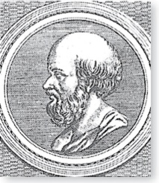
The Sieve of Erastosthenes
Erastothenes
(276-194 B.C.)
The Sieve of Erastosthenes can be used to find all primes not exceeding a specified positive integer. For example, begin with the list of integers between 1 and 100.
Delete all the integers, other than 2, divisible by 2.
Delete all the integers, other than 3, divisible by 3.
Next, delete all the integers, other than 5, divisible by 5.
Next, delete all the integers, other than 7, divisible by 7.
Since all the remaining integers are not divisible by any of the previous integers, other than 1, the primes are:
{2,3,7,11,19,23,29,31,37,41,43,47,53,59,61,67,71,73,79,83,89, 97}
continued →

Slide 71
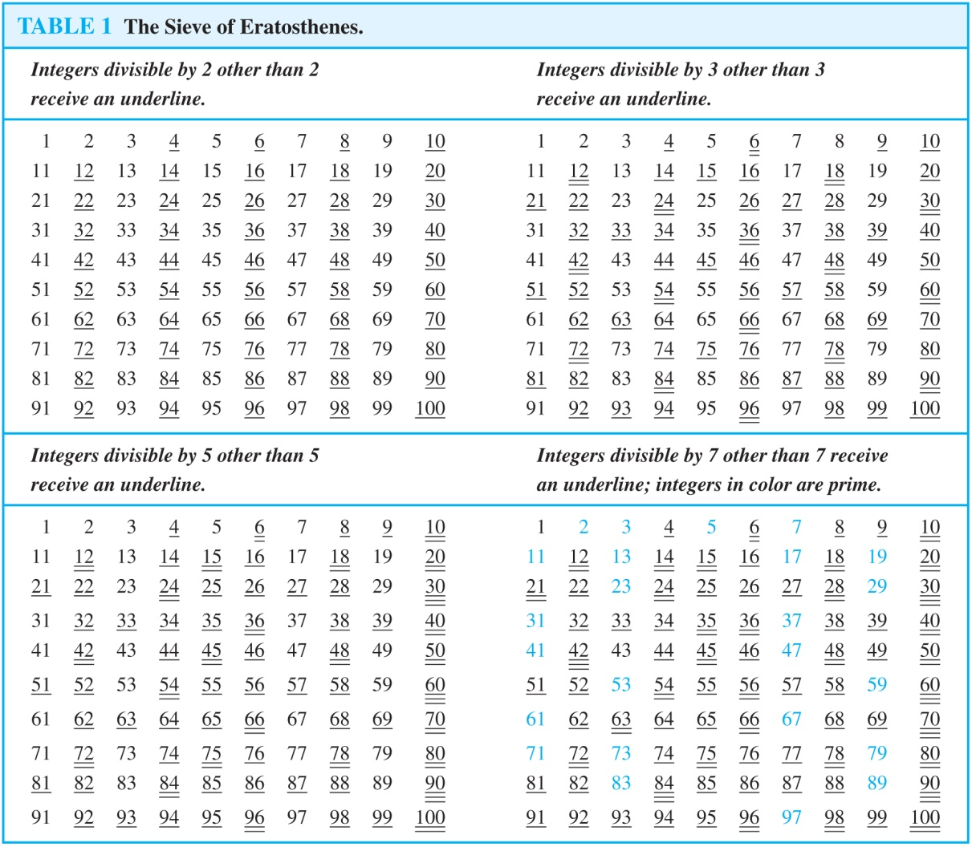
The Sieve of Erastosthenes
If an integer n is a composite integer, then it has a prime divisor less than or equal to √n.
To see this, note that if n = ab, then a ≤ √n or b ≤√n.
Trial division, a very inefficient method of determining if a number n is prime, is to try every integer i ≤√n and see if n is divisible by i.

Slide 72
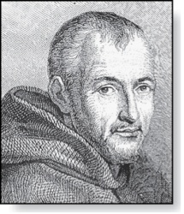
Mersenne Primes
Marin Mersenne
(1588-1648)
Definition: Prime numbers of the form 2^{p} − 1 , where p is prime, are called Mersenne primes.
2² − 1 = 3, 2³ − 1 = 7, 2⁵ − 1 = 37 , and 2⁷ − 1 = 127 are Mersenne primes.
2¹¹ − 1 = 2047 is not a Mersenne prime since 2047 = 23∙89.
There is an efficient test for determining if 2^{p} − 1 is prime.
The largest known prime numbers are Mersenne primes.
As of mid 2011, 47 Mersenne primes were known, the largest is 2^{43,112,609} − 1, which has nearly 13 million decimal digits.
The Great Internet Mersenne Prime Search (GIMPS) is a distributed computing project to search for new Mersenne Primes.
http://www.mersenne.org/

Slide 73
Greatest Common Divisor
Definition: Let a and b be integers, not both zero. The largest integer d such that d | a and also d | b is called the greatest common divisor of a and b. The greatest common divisor of a and b is denoted by gcd(a,b).
One can find greatest common divisors of small numbers by inspection.
Example: What is the greatest common divisor of 24 and 36?
Solution: gcd(24,36) = 12
Example: What is the greatest common divisor of 17 and 22?
Solution: gcd(17,22) = 1

Slide 74
Greatest Common Divisor
Definition: The integers a and b are relatively prime if their greatest common divisor is 1.
Example: 17 and 22
Definition: The integers a₁, a₂, …, a_{n} are pairwise relatively prime if gcd(a_{i}, a_{j})= 1 whenever 1 ≤ i<j ≤n.
Example: Determine whether the integers 10, 17 and 21 are pairwise relatively prime.
Solution: Because gcd(10,17) = 1, gcd(10,21) = 1, and gcd(17,21) = 1, 10, 17, and 21 are pairwise relatively prime.
Example: Determine whether the integers 10, 19, and 24 are pairwise relatively prime.
Solution: Because gcd(10,24) = 2, 10, 19, and 24 are not pairwise relatively prime.

Slide 75
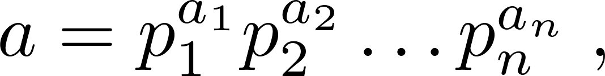
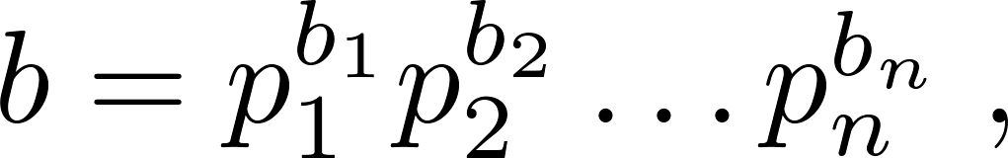
Finding the Greatest Common Divisor Using Prime Factorizations
Suppose the prime factorizations of a and b are:
where each exponent is a nonnegative integer, and where all primes occurring in either prime factorization are included in both. Then:
This formula is valid since the integer on the right (of the equals sign) divides both a and b. No larger integer can divide both a and b.
Example: 120 = 2³ ∙3 ∙5 500 = 2² ∙5³
gcd(120,500) = 2^{min(3,2)} ∙3^{min(1,0)} ∙5^{min(1,3)} = 2² ∙3⁰ ∙5¹ = 20
Finding the gcd of two positive integers using their prime factorizations is not efficient because there is no efficient algorithm for finding the prime factorization of a positive integer.

Slide 76
Least Common Multiple
Definition: The least common multiple of the positive integers a and b is the smallest positive integer that is divisible by both a and b. It is denoted by lcm(a,b).
The least common multiple can also be computed from the prime factorizations.
This number is divided by both a and b and no smaller number is divided by a and b.
Example: lcm(2³3⁵7², 2⁴3³) = 2^{max(3,4)} 3^{max(5,3)} 7^{max(2,0)} = 2⁴ 3⁵ 7²
The greatest common divisor and the least common multiple of two integers are related by:
Theorem 5: Let a and b be positive integers. Then
ab = gcd(a,b) ∙lcm(a,b)
(proof is Exercise 31)

Slide 77

Euclidean Algorithm
Euclid
(325 B.C.E. – 265 B.C.E.)
The Euclidian algorithm is an efficient method for computing the greatest common divisor of two integers. It is based on the idea that gcd(a,b) is equal to gcd(a,c) when a > b and c is the remainder when a is divided by b.
Example: Find gcd(91, 287):
287 = 91 ∙ 3 + 14
91 = 14 ∙ 6 + 7
14 = 7 ∙ 2 + 0
gcd(287, 91) = gcd(91, 14) = gcd(14, 7) = 7
Divide 287 by 91
Divide 91 by 14
Divide 14 by 7
Stopping condition
continued →

Slide 78
Euclidean Algorithm
The Euclidean algorithm expressed in pseudocode is:
In Section 5.3, we’ll see that the time complexity of the algorithm is O(log b), where a > b.
procedure gcd(a, b: positive integers)
x := a
x := b
while y ≠ 0
r := x mod y
x := y
y := r
return x {gcd(a,b) is x}

Slide 79
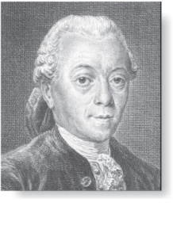
gcds as Linear Combinations
Étienne Bézout
(1730-1783)
Bézout’s Theorem: If a and b are positive integers, then there exist integers s and t such that gcd(a,b) = sa + tb.
(proof in exercises of Section 5.2)
Definition: If a and b are positive integers, then integers s and t such that gcd(a,b) = sa + tb are called Bézout coefficients of a and b. The equation gcd(a,b) = sa + tb is called Bézout’s identity.
By Bézout’s Theorem, the gcd of integers a and b can be expressed in the form sa + tb where s and t are integers. This is a linear combination with integer coefficients of a and b.
gcd(6,14) = (−2)∙6 + 1∙14

Slide 80
Finding gcds as Linear Combinations
Example: Express gcd(252,198) = 18 as a linear combination of 252 and 198.
Solution: First use the Euclidean algorithm to show gcd(252,198) = 18
252 = 1∙198 + 54
198 = 3 ∙54 + 36
54 = 1 ∙36 + 18
36 = 2 ∙18
Now working backwards, from iii and i above
18 = 54 − 1 ∙36
36 = 198 − 3 ∙54
Substituting the 2nd equation into the 1st yields:
18 = 54 − 1 ∙(198 − 3 ∙54 )= 4 ∙54 − 1 ∙198
Substituting 54 = 252 − 1 ∙198 (from i)) yields:
18 = 4 ∙(252 − 1 ∙198) − 1 ∙198 = 4 ∙252 − 5 ∙198
This method illustrated above is a two pass method. It first uses the Euclidian algorithm to find the gcd and then works backwards to express the gcd as a linear combination of the original two integers. A one pass method, called the extended Euclidean algorithm, is developed in the exercises.

Slide 81
Dividing Congruencies by an Integer
Dividing both sides of a valid congruence by an integer does not always produce a valid congruence (see Section 4.1).
But dividing by an integer relatively prime to the modulus does produce a valid congruence:
Theorem 7: Let m be a positive integer and let a, b, and c be integers. If ac ≡ bc (mod m) and gcd(c,m) = 1, then a ≡ b (mod m).
Proof: Since ac ≡ bc (mod m), m | ac − bc = c(a − b) by Lemma 2 and the fact that gcd(c,m) = 1, it follows that m | a − b. Hence, a ≡ b (mod m).

Slide 82
Solving Congruencies
Section 4.4

Slide 83
Section Summary
Linear Congruencies
The Chinese Remainder Theorem
Fermat’s Little Theorem
Pseudo primes

Slide 84
Linear Congruencies
Definition: A congruence of the form
ax ≡ b( mod m),
where m is a positive integer, a and b are integers, and x is a variable, is called a linear congruence.
The solutions to a linear congruence ax≡ b( mod m) are all integers x that satisfy the congruence.
Definition: An integer ā such that āa ≡ 1( mod m) is said to be an inverse of a modulo m.
Example: 5 is an inverse of 3 modulo 7 since 5∙3 = 15 ≡ 1(mod 7)
One method of solving linear congruencies makes use of an inverse ā, if it exists. Although we can not divide both sides of the congruence by a, we can multiply by ā to solve for x.

Slide 85
Inverse of a modulo m
The following theorem guarantees that an inverse of a modulo m exists whenever a and m are relatively prime. Two integers a and b are relatively prime when gcd(a,b) = 1.
Theorem 1: If a and m are relatively prime integers and m > 1, then an inverse of a modulo m exists. Furthermore, this inverse is unique modulo m. (This means that there is a unique positive integer ā less than m that is an inverse of a modulo m and every other inverse of a modulo m is congruent to ā modulo m.)
Proof: Since gcd(a,m) = 1, by Theorem 6 of Section 4.3, there are integers s and t such that sa + tm = 1.
Hence, sa + tm ≡ 1 ( mod m).
Since tm ≡ 0 ( mod m), it follows that sa ≡ 1 ( mod m)
Consequently, s is an inverse of a modulo m.
The uniqueness of the inverse is Exercise 7.

Slide 86
Finding Inverses
The Euclidean algorithm and Bézout coefficients gives us a systematic approaches to finding inverses.
Example: Find an inverse of 3 modulo 7.
Solution: Because gcd(3,7) = 1, by Theorem 1, an inverse of 3 modulo 7 exists.
Using the Euclidian algorithm: 7 = 2∙3 + 1.
From this equation, we get −2∙3 + 1∙7 = 1, and see that −2 and 1 are Bézout coefficients of 3 and 7.
Hence, −2 is an inverse of 3 modulo 7.
Also every integer congruent to −2 modulo 7 is an inverse of 3 modulo 7, i.e., 5, −9, 12, etc.

Slide 87
Finding Inverses
Example: Find an inverse of 101 modulo 4620.
Solution: First use the Euclidian algorithm to show that gcd(101,4620) = 1.
Working Backwards:
42620 = 45∙101 + 75
101 = 1∙75 + 26
75 = 2∙26 + 23
26 = 1∙23 + 3
23 = 7∙3 + 2
3 = 1∙2 + 1
2 = 2∙1
1 = 3 − 1∙2
1 = 3 − 1∙(23 − 7∙3) = − 1 ∙23 + 8∙3
1 = −1∙23 + 8∙(26 − 1∙23) = 8∙26 − 9 ∙23
1 = 8∙26 − 9 ∙(75 − 2∙26 )= 26∙26 − 9 ∙75
1 = 26∙(101 − 1∙75) − 9 ∙75
= 26∙101 − 35 ∙75
1 = 26∙101 − 35 ∙(42620 − 45∙101)
= − 35 ∙42620 + 1601∙101
Since the last nonzero
remainder is 1,
gcd(101,4260) = 1
Bézout coefficients : − 35 and 1601
1601 is an inverse of 101 modulo 42620

Slide 88
Using Inverses to Solve Congruences
We can solve the congruence ax≡ b( mod m) by multiplying both sides by ā.
Example: What are the solutions of the congruence 3x≡ 4( mod 7).
Solution: We found that −2 is an inverse of 3 modulo 7 (two slides back). We multiply both sides of the congruence by −2 giving
−2 ∙ 3x ≡ −2 ∙ 4(mod 7).
Because −6 ≡ 1 (mod 7) and −8 ≡ 6 (mod 7), it follows that if x is a solution, then x ≡ −8 ≡ 6 (mod 7)
We need to determine if every x with x ≡ 6 (mod 7) is a solution. Assume that x ≡ 6 (mod 7). By Theorem 5 of Section 4.1, it follows that 3x ≡ 3 ∙ 6 = 18 ≡ 4( mod 7) which shows that all such x satisfy the congruence.
The solutions are the integers x such that x ≡ 6 (mod 7), namely, 6,13,20 … and −1, − 8, − 15,…

Slide 89
The Chinese Remainder Theorem
Theorem 2: (The Chinese Remainder Theorem) Let m₁,m₂,…,m_{n} be pairwise relatively prime positive integers greater than one and a₁,a₂,…,a_{n} arbitrary integers. Then the system
x ≡ a₁ ( mod m₁)
x ≡ a₂ ( mod m₂)
∙
∙
∙
x ≡ a_{n} ( mod m_{n})
has a unique solution modulo m = m₁m₂ ∙ ∙ ∙ m_{n}.
(That is, there is a solution x with 0 ≤ x <m and all other solutions are congruent modulo m to this solution.)
Proof: We’ll show that a solution exists by describing a way to construct the solution. Showing that the solution is unique modulo m is Exercise 30.
continued →

Slide 90
The Chinese Remainder Theorem
To construct a solution first let M_{k}=m/m_{k} for k = 1,2,…,n and m = m₁m₂ ∙ ∙ ∙ m_{n}.
Since gcd(m_{k} ,M_{k} ) = 1, by Theorem 1, there is an integer y_{k} , an inverse of M_{k} modulo m_{k}, such that
M_{k} y_{k} ≡ 1 ( mod m_{k} ).
Form the sum
x = a₁ M₁ y₁ + a₂ M₂ y₂ + ∙ ∙ ∙ + a_{n} M_{n} y_{n} .
Note that because M_{j} ≡ 0 ( mod m_{k}) whenever j ≠k , all terms except the kth term in this sum are congruent to 0 modulo m_{k} .
Because M_{k} y_{k} ≡ 1 ( mod m_{k} ), we see that x ≡ a_{k} M_{k} y_{k} ≡ a_{k}( mod m_{k}), for k = 1,2,…,n.
Hence, x is a simultaneous solution to the n congruences.
x ≡ a₁ ( mod m₁)
x ≡ a₂ ( mod m₂)
∙
∙
∙
x ≡ a_{n} ( mod m_{n})

Slide 91
The Chinese Remainder Theorem
Example: Consider the 3 congruences from Sun-Tsu’s problem:
x ≡ 2 ( mod 3), x ≡ 3 ( mod 5), x ≡ 2 ( mod 7).
Let m = 3∙ 5 ∙ 7 = 105, M₁ = m/3 = 35, M₃ = m/5 = 21, M₃ = m/7 = 15.
We see that
2 is an inverse of M₁ = 35 modulo 3 since 35 ∙ 2 ≡ 2 ∙ 2 ≡ 1 (mod 3)
1 is an inverse of M₂ = 21 modulo 5 since 21 ≡ 1 (mod 5)
1 is an inverse of M₃ = 15 modulo 7 since 15 ≡ 1 (mod 7)
Hence,
x = a₁M₁y₁ + a₂M₂y₂ + a₃M₃y₃
= 2 ∙ 35 ∙ 2 + 3 ∙ 21 ∙ 1 + 2 ∙ 15 ∙ 1 = 233 ≡ 23 (mod 105)
We have shown that 23 is the smallest positive integer that is a simultaneous solution. Check it!

Slide 92
Problem:
Jessica breeds rabbits. She's not sure exactly how many she has today, but as she was moving them about this morning, she noticed some things. When she fed them, in groups of 5, she had 4 left over. When she bathed them, in groups of 8, she had a group of 6 left over. She took them outside to romp in groups of 9, but then the last group consisted of only 8. She's positive that there are fewer than 250 rabbits - but how many does she have?

Slide 93
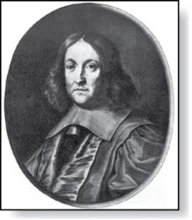
Fermat’s Little Theorem
Pierre de Fermat
(1601-1665)
Theorem 3: (Fermat’s Little Theorem) If p is prime and a is an integer not divisible by p, then a^{p-1} ≡ 1 (mod p)
Furthermore, for every integer a we have a^{p} ≡ a (mod p)
(proof outlined in Exercise 19)
Fermat’s little theorem is useful in computing the remainders modulo p of large powers of integers.
Example: Find 7²²² mod 11.
By Fermat’s little theorem, we know that 7¹⁰ ≡ 1 (mod 11), and so (7¹⁰ )^{k} ≡ 1 (mod 11), for every positive integer k. Therefore,
7²²² = 7^{22∙10 + 2} = (7¹⁰)²²7² ≡ (1)²² ∙49 ≡ 5 (mod 11).
Hence, 7²²² mod 11 = 5.

Slide 94
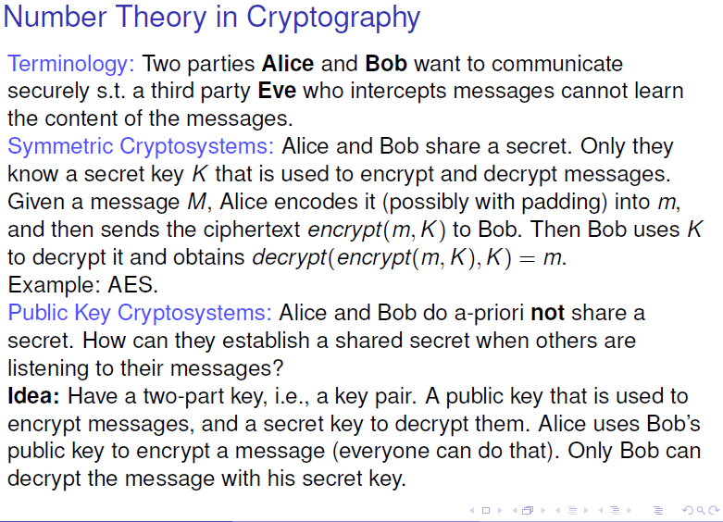

Slide 95
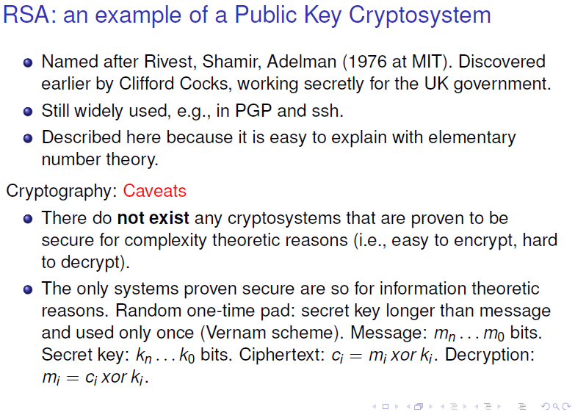

Slide 96
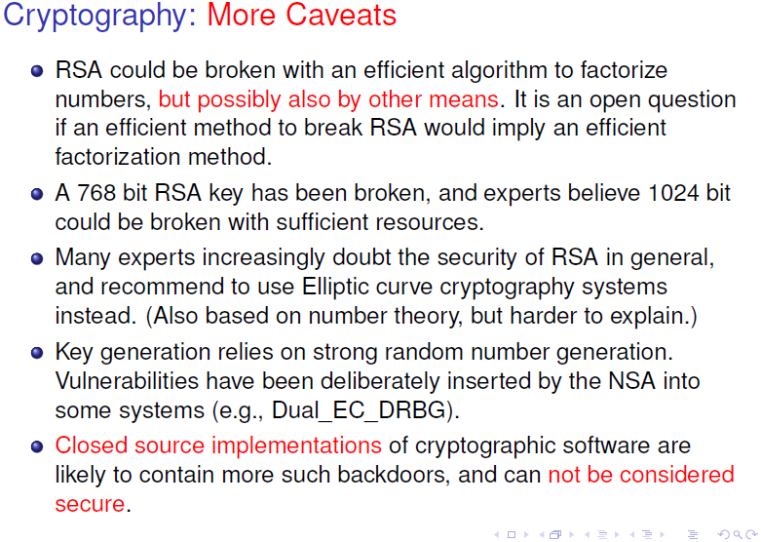

Slide 97
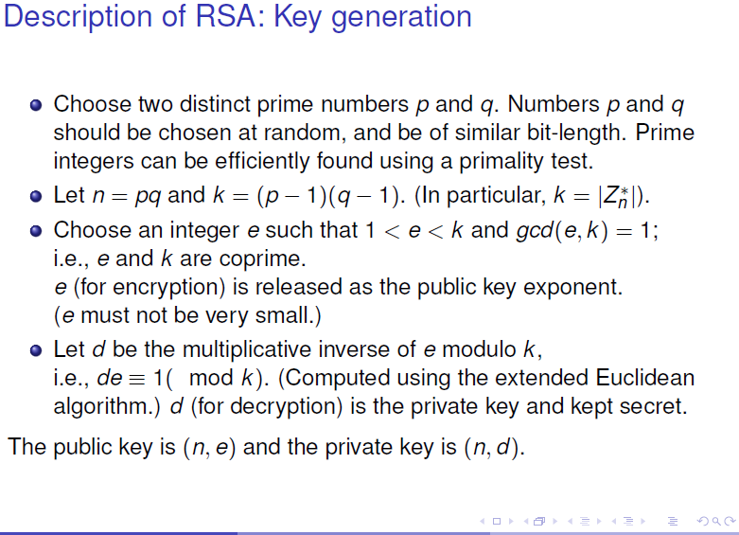

Slide 98
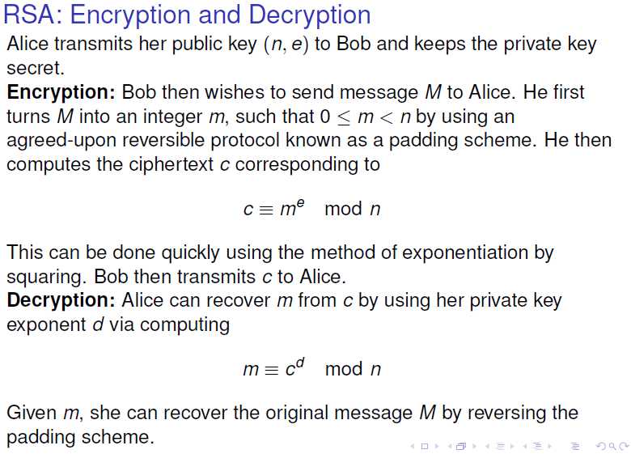

Slide 99
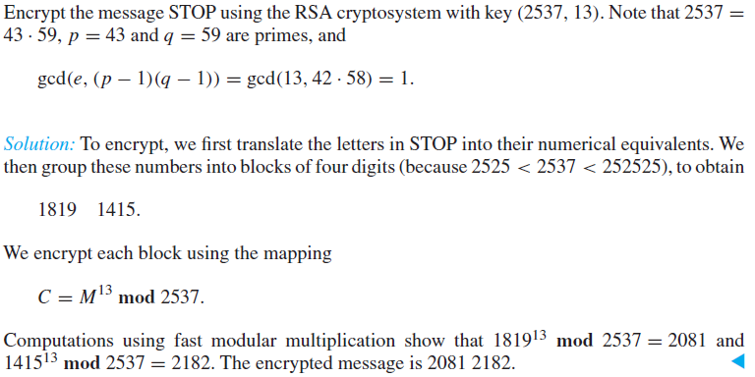
`

Slide 100
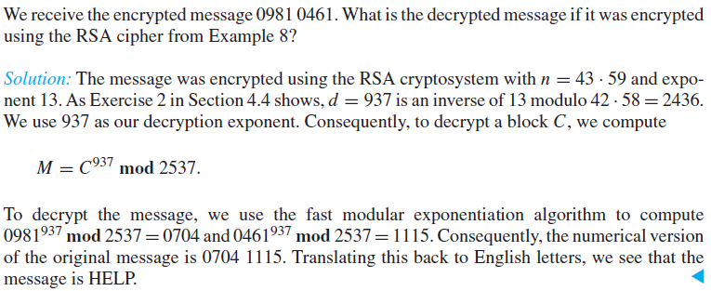

Slide 101
The RSA Algorithm
To generate a key pair:
– Pick large primes p and q (do not disclose them)
– Let n = p*q
– For the public key, choose e that is relatively prime to ø(n)=(p-1)(q-1).
public key = <e,n>
– For private key, find d that is the multiplicative inverse of e mod ø(n), i.e., e*d

Slide 102
Using RSA
Given pubKey = <e, n> and privKey = <d, n>
If Message = m
Then:
encryption: c = m^{e} mod n, m < n
decryption: m = c^{d} mod n
signature: s = md mod n, m < n
verification: m = se mod n

Slide 103
Example of RSA (1)
Choose p = 7 and q = 17.
Compute n = p*q= 119.
Compute f(n)=(p-1)(q-1)=96.
Select e = 5, (a relatively prime to f(n).)
Compute d = _77_such that e*d=1 mod f(n).
• Public key: <5,119>
• Private key: <77,119>
• Message = 19
• Encryption: 19⁵ mod 119 = 66
• Decryption: 66⁷⁷ mod 119 = 19

Slide 104
Example of RSA (2)
p = 7, q = 11, n = 77
Alice chooses e = 17, making d = 53
Bob wants to send Alice secret message
HELLO (07 04 11 11 14)
– 07¹⁷ mod 77 = 28; 04¹⁷ mod 77 = 16
– 11¹⁷ mod 77 = 44; – 11¹⁷ mod 77 = 44
– 14¹⁷ mod 77 = 42
• Bob sends 28 16 44 44 42

Slide 105
Example of RSA (3)
Alice receives 28 16 44 44 42
Alice uses private key, d = 53, to decrypt message:
– 28⁵³ mod 77 = 07; 16⁵³ mod 77 = 04
– 44⁵³ mod 77 = 11; 44⁵³ mod 77 = 11
– 42⁵³ mod 77 = 14
• Alice translates 07 04 11 11 14 to HELLO
No one else could read it, as only Alice knows her
private key (needed for decryption)

Slide 106
Graphs
Chapter 10

Slide 107
Chapter Summary
Graphs and Graph Models
Graph Terminology and Special Types of Graphs
Representing Graphs and Graph Isomorphism
Connectivity
Euler and Hamiltonian Graphs
Shortest-Path Problems
Planar Graphs
Graph Coloring

Slide 108
Graphs and Graph Models
Section 10.1

Slide 109
Section Summary
Introduction to Graphs
Graph Taxonomy
Graph Models

Slide 110
Graphs
Definition: A graph G = (V, E) consists of a nonempty set V of vertices (or nodes) and a set E of edges. Each edge has either one or two vertices associated with it, called its endpoints. An edge is said to connect its endpoints.
Remarks:
The graphs we study here are unrelated to graphs of functions studied in Chapter 2.
We have a lot of freedom when we draw a picture of a graph. All that matters is the connections made by the edges, not the particular geometry depicted. For example, the lengths of edges, whether edges cross, how vertices are depicted, and so on, do not matter
A graph with an infinite vertex set is called an infinite graph. A graph with a finite vertex set is called a finite graph. We (following the text) restrict our attention to finite graphs.
Example:
a
b
This is a graph with four vertices and five edges.
d
c

Slide 111
Some Terminology
In a simple graph each edge connects two different vertices and no two edges connect the same pair of vertices.
Multigraphs may have multiple edges connecting the same two vertices. When m different edges connect the vertices u and v, we say that {u,v} is an edge of multiplicity m.
An edge that connects a vertex to itself is called a loop.
A pseudograph may include loops, as well as multiple edges connecting the same pair of vertices.
Example:
This pseudograph has both multiple edges and a loop.
a
b
Remark: There is no standard terminology for graph theory. So, it is crucial that you understand the terminology being used whenever you read material about graphs.
c

Slide 112
Directed Graphs
Definition: An directed graph (or digraph) G = (V, E) consists of a nonempty set V of vertices (or nodes) and a set E of directed edges (or arcs). Each edge is associated with an ordered pair of vertices. The directed edge associated with the ordered pair (u,v) is said to start at u and end at v.
Remark:
Graphs where the end points of an edge are not ordered are said to be undirected graphs.

Slide 113
Some Terminology (continued)
A simple directed graph has no loops and no multiple edges.
A directed multigraph may have multiple directed edges. When there are m directed edges from the vertex u to the vertex v, we say that (u,v) is an edge of multiplicity m.
Example:
a
b
This is a directed graph with three vertices and four edges.
c
Example:
In this directed multigraph the multiplicity of (a,b) is 1 and the multiplicity of (b,c) is 2.
a
b
c

Slide 114
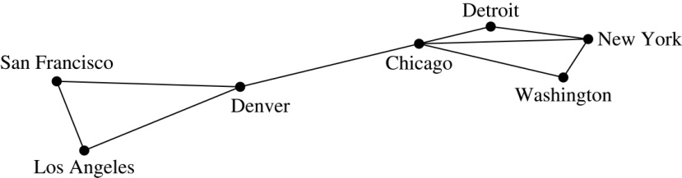
Graph Models: Computer Networks
When we build a graph model, we use the appropriate type of graph to capture the important features of the application.
We illustrate this process using graph models of different types of computer networks. In all these graph models, the vertices represent data centers and the edges represent communication links.
To model a computer network where we are only concerned whether two data centers are connected by a communications link, we use a simple graph. This is the appropriate type of graph when we only care whether two data centers are directly linked (and not how many links there may be) and all communications links work in both directions.

Slide 115
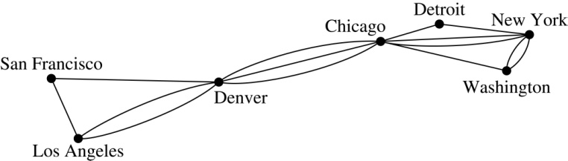
Graph Models: Computer Networks (continued)
To model a computer network where we care about the number of links between data centers, we use a multigraph.

Slide 116
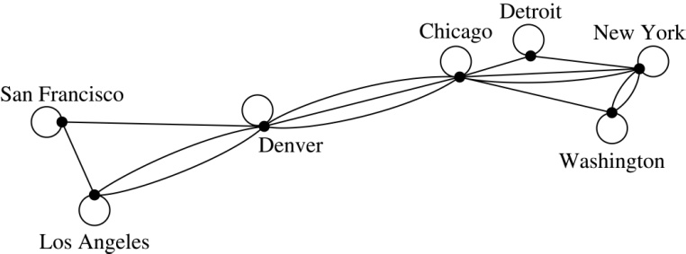
Graph Models: Computer Networks
To model a computer network with diagnostic links at data centers, we use a pseudograph, as loops are needed.

Slide 117
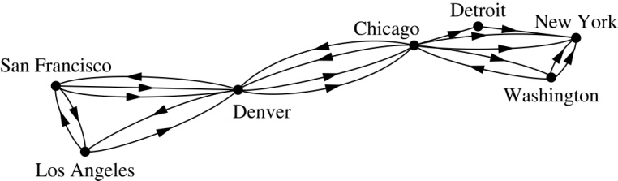
Graph Models: Computer Networks
To model a network with multiple one-way links, we use a directed multigraph. Note that we could use a directed graph without multiple edges if we only care whether there is at least one link from a data center to another data center.

Slide 118
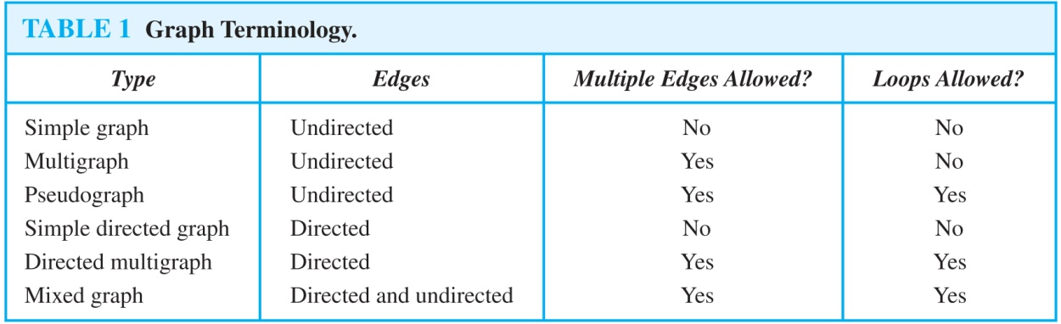
Graph Terminology: Summary
To understand the structure of a graph and to build a graph model, we ask these questions:
Are the edges of the graph undirected or directed (or both)?
If the edges are undirected, are multiple edges present that connect the same pair of vertices? If the edges are directed, are multiple directed edges present?
Are loops present?

Slide 119
Other Applications of Graphs
We will illustrate how graph theory can be used in models of:
Social networks
Communications networks
Information networks
Software design
Transportation networks
Biological networks
It’s a challenge to find a subject to which graph theory has not yet been applied. Can you find an area without applications of graph theory?

Slide 120
Graph Models: Social Networks
Graphs can be used to model social structures based on different kinds of relationships between people or groups.
In a social network, vertices represent individuals or organizations and edges represent relationships between them.
Useful graph models of social networks include:
friendship graphs - undirected graphs where two people are connected if they are friends (in the real world, on Facebook, or in a particular virtual world, and so on.)
collaboration graphs - undirected graphs where two people are connected if they collaborate in a specific way
influence graphs - directed graphs where there is an edge from one person to another if the first person can influence the second person..

Slide 121
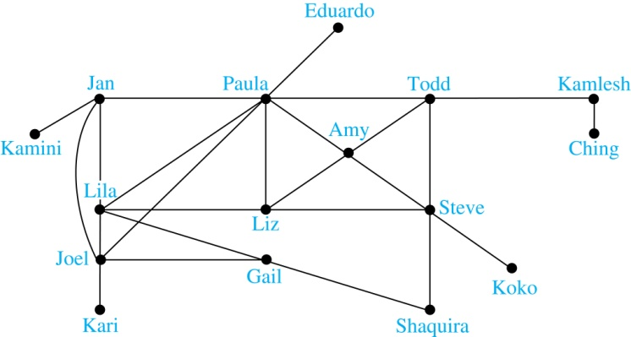
Graph Models: Social Networks
Example: A friendship graph where two people are connected if they are Facebook friends.

Slide 122
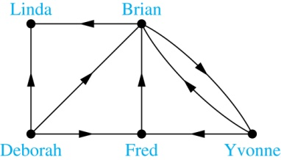
Graph Models: Social Networks
Example: An influence graph

Slide 123
Applications to Information Networks
Graphs can be used to model different types of networks that link different types of information.
In a web graph, web pages are represented by vertices and links are represented by directed edges.
A web graph models the web at a particular time.
We will explain how the web graph is used by search engines in Section 11.4.
In a citation network:
Research papers in a particular discipline are represented by vertices.
When a paper cites a second paper as a reference, there is an edge from the vertex representing this paper to the vertex representing the second paper.

Slide 124
Transportation Graphs
Graph models are extensively used in the study of transportation networks.
Airline networks can be modeled using directed multigraphs where
airports are represented by vertices
each flight is represented by a directed edge from the vertex representing the departure airport to the vertex representing the destination airport
Road networks can be modeled using graphs where
vertices represent intersections and edges represent roads.
undirected edges represent two-way roads and directed edges represent one-way roads.

Slide 125
Software Design Applications
Graph models are extensively used in software design. We will introduce two such models here; one representing the dependency between the modules of a software application and the other representing restrictions in the execution of statements in computer programs.
When a top-down approach is used to design software, the system is divided into modules, each performing a specific task.
We use a module dependency graph to represent the dependency between these modules. These dependencies need to be understood before coding can be done.

Slide 126
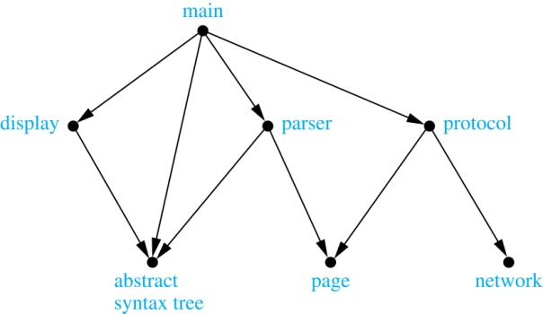
Software Design Applications
In a module dependency graph vertices represent software modules and there is an edge from one module to another if the second module depends on the first.
Example: The dependencies between the seven modules in the design of a web browser are represented by this module dependency graph.

Slide 127
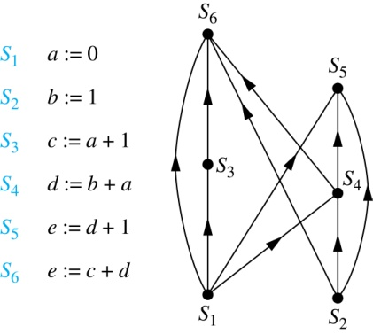
Software Design Applications
We can use a directed graph called a precedence graph to represent which statements must have already been executed before we execute each statement.
Vertices represent statements in a computer program
There is a directed edge from a vertex to a second vertex if the second vertex cannot be executed before the first
Example: This precedence graph shows which statements must already have been executed before we can execute each of the six statements in the program.

Slide 128
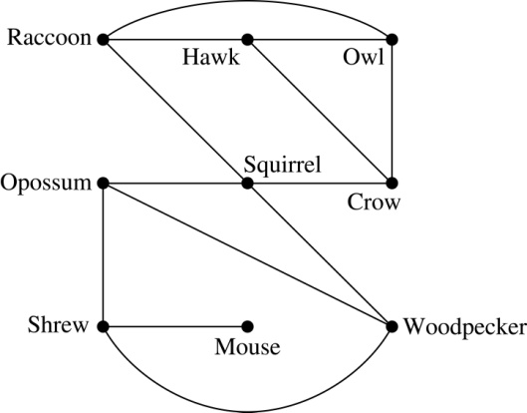
Biological Applications
Graph models are used extensively in many areas of the biological science. We will describe two such models, one to ecology and the other to molecular biology.
Niche overlap graphs model competition between species in an ecosystem
Vertices represent species and an edge connects two vertices when they represent species who compete for food resources.
Example: This is the niche overlap graph for a forest ecosystem with nine species.

Slide 129
Biological Applications
We can model the interaction of proteins in a cell using a protein interaction network.
In a protein interaction graph, vertices represent proteins and vertices are connected by an edge if the proteins they represent interact.
Protein interaction graphs can be huge and can contain more than 100,000 vertices, each representing a different protein, and more than 1,000,000 edges, each representing an interaction between proteins
Protein interaction graphs are often split into smaller graphs, called modules, which represent the interactions between proteins involved in a particular function.

Slide 130
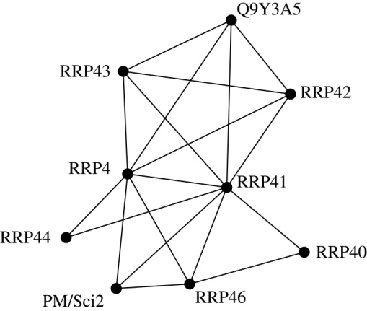
Biological Applications
Example: This is a module of the protein interaction graph of
proteins that degrade RNA in a human cell.

Slide 131
Graph Terminology and Special Types of Graphs
Section 10.2

Slide 132
Section Summary
Basic Terminology
Some Special Types of Graphs
Bipartite Graphs
Bipartite Graphs and Matchings
Some Applications of Special Types of Graphs
New Graphs from Old

Slide 133
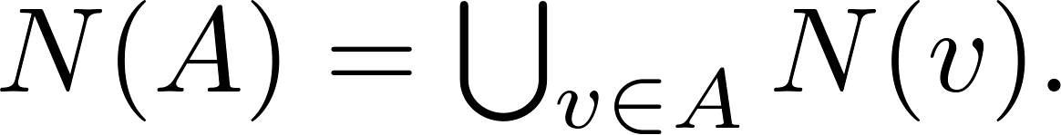
Basic Terminology
Definition 1. Two vertices u, v in an undirected graph G are called adjacent (or neighbors) in G if there is an edge e between u and v. Such an edge e is called incident with the vertices u and v and e is said to connect u and v.
Definition 2. The set of all neighbors of a vertex v of G = (V, E), denoted by N(v), is called the neighborhood of v. If A is a subset of V, we denote by N(A) the set of all vertices in G that are adjacent to at least one vertex in A. So,
Definition 3. The degree of a vertex in a undirected graph is the number of edges incident with it, except that a loop at a vertex contributes two to the degree of that vertex. The degree of the vertex v is denoted by deg(v).

Slide 134
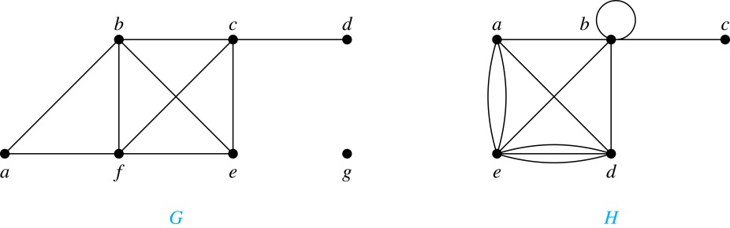
Degrees and Neighborhoods of Vertices
Example: What are the degrees and neighborhoods of the vertices in the graphs G and H?
Solution:
G: deg(a) = 2, deg(b) = deg(c) = deg(f ) = 4, deg(d ) = 1, deg(e) = 3, deg(g) = 0.
N(a) = {b, f }, N(b) = {a, c, e, f }, N(c) = {b, d, e, f }, N(d) = {c},
N(e) = {b, c , f }, N(f) = {a, b, c, e}, N(g) =  .
H: deg(a) = 4, deg(b) = deg(e) = 6, deg(c) = 1, deg(d) = 5.
N(a) = {b, d, e}, N(b) = {a, b, c, d, e}, N(c) = {b}, N(d) = {a, b, e},
N(e) = {a, b ,d}.

Slide 135
Handshaking Theorem
Theorem: If G is any graph, then the sum of the degrees of all the vertices of G equals twice the number of edges of G.
Specifically, if the vertices of G are v1, v2, …, vn, where n is a positive integer, then
the total degree of G = deg(v1) + deg(v2) + … + deg(vn) = 2 . (the number of edges of G)
PROOF:
Each edge “e” of G connects its end points vi and vj. This edge, therefore contributes 1 to the degree of vi and 1 to the degree of vj.
If “e” is a loop, then it is counted twice in computing the degree of the vertex on which it is incident.
Accordingly, each edge of G contributes 2 to the total degree of G.
Thus, the total degree of G = 2. (the number of edges of G)
COROLLARY: The total degree of G is an even number

Slide 136
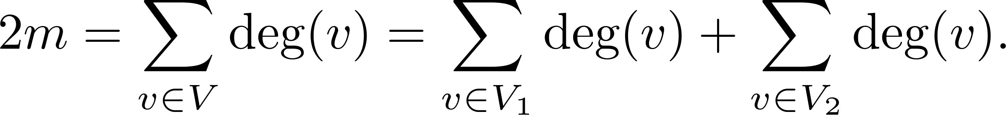
Degree of Vertices
Theorem: An undirected graph has an even number of vertices of odd degree.
Proof: Let V₁ be the vertices of even degree and V₂ be the vertices of odd degree in an undirected graph G = (V, E) with m edges. Then
even
must be even since deg(v) is even for each v ∈ V₁
This sum must be even because 2m is even and the sum of the degrees of the vertices of even degrees is also even. Because this is the sum of the degrees of all vertices of odd degree in the graph, there must be an even number of such vertices.

Slide 137
Handshaking Theorem
We now give two examples illustrating the usefulness of the handshaking theorem.
Example: How many edges are there in a graph with 10 vertices of degree six?
Solution: Because the sum of the degrees of the vertices is 6  10 = 60, the handshaking theorem tells us that 2m = 60. So the number of edges m = 30.
Example: If a graph has 5 vertices, can each vertex have degree 3?
Solution: This is not possible by the handshaking thoerem, because the sum of the degrees of the vertices 3  5 = 15 is odd.

Slide 138
Directed Graphs
Recall the definition of a directed graph.
Definition: An directed graph G = (V, E) consists of V, a nonempty set of vertices (or nodes), and E, a set of directed edges or arcs. Each edge is an ordered pair of vertices. The directed edge (u,v) is said to start at u and end at v.
Definition: Let (u,v) be an edge in G. Then u is the initial vertex of this edge and is adjacent to v and v is the terminal (or end) vertex of this edge and is adjacent from u. The initial and terminal vertices of a loop are the same.

Slide 139
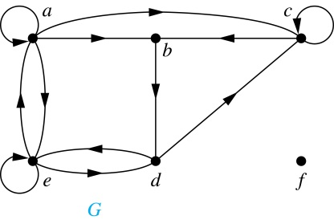
Directed Graphs (continued)
Definition: The in-degree of a vertex v, denoted deg⁻(v), is the number of edges which terminate at v. The out-degree of v, denoted deg⁺(v), is the number of edges with v as their initial vertex. Note that a loop at a vertex contributes 1 to both the in-degree and the out-degree of the vertex.
Example: In the graph G we have
deg⁻(a) = 2, deg⁻(b) = 2, deg⁻(c) = 3, deg⁻(d) = 2, deg⁻(e) = 3, deg⁻(f) = 0.
deg⁺(a) = 4, deg⁺(b) = 1, deg⁺(c) = 2, deg⁺(d) = 2, deg⁺ (e) = 3, deg⁺(f) = 0.

Slide 140
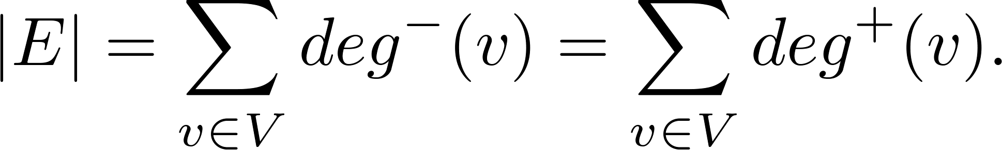
Directed Graphs (continued)
Theorem 3: Let G = (V, E) be a graph with directed edges. Then:
Proof: The first sum counts the number of outgoing edges over all vertices and the second sum counts the number of incoming edges over all vertices. It follows that both sums equal the number of edges in the graph.

Slide 141
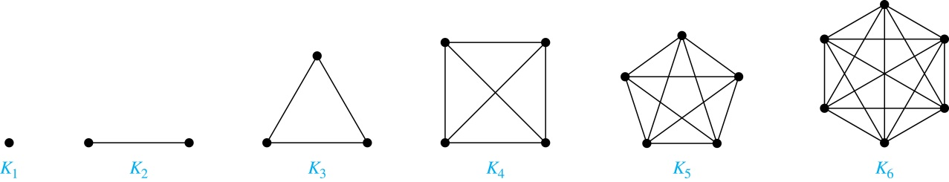
Special Types of Simple Graphs: Complete Graphs
A complete graph on n vertices, denoted by K_{n}, is the simple graph that contains exactly one edge between each pair of distinct vertices.

Slide 142
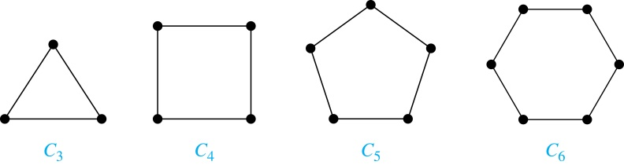
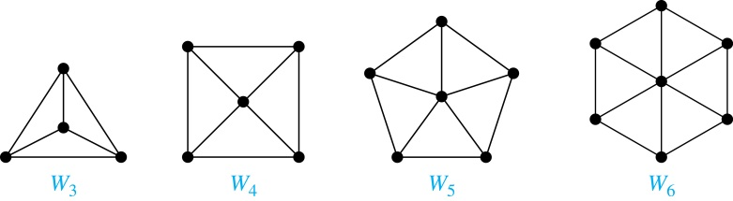
Special Types of Simple Graphs: Cycles and Wheels
A cycle C_{n} for n ≥ 3 consists of n vertices v₁, v₂ ,⋯ , v_{n}, and edges {v₁, v₂}, {v₂, v₃} ,⋯ , {v_{n-1}, v_{n}}, {v_{n}, v₁}.
A wheel W_{n} is obtained by adding an additional vertex to a cycle C_{n} for n ≥ 3 and connecting this new vertex to each of the n vertices in C_{n} by new edges.

Slide 143
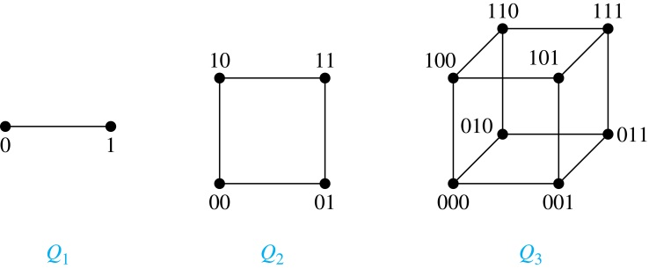
Special Types of Simple Graphs: n-Cubes
An n-dimensional hypercube, or n-cube, Q_{n}, is a graph with 2^{n} vertices representing all bit strings of length n, where there is an edge between two vertices that differ in exactly one bit position.

Slide 144
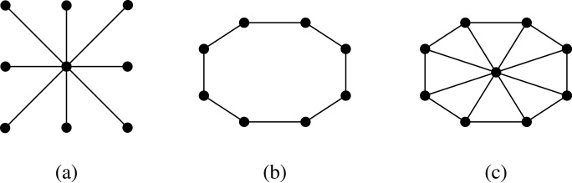
Special Types of Graphs and Computer Network Architecture
Various special graphs play an important role in the design of computer networks.
Some local area networks use a star topology, which is a complete bipartite graph K_{1,n} ,as shown in (a). All devices are connected to a central control device.
Other local networks are based on a ring topology, where each device is connected to exactly two others using C_{n} ,as illustrated in (b). Messages may be sent around the ring.
Others, as illustrated in (c), use a W_{n} – based topology, combining the features of a star topology and a ring topology.

Slide 145
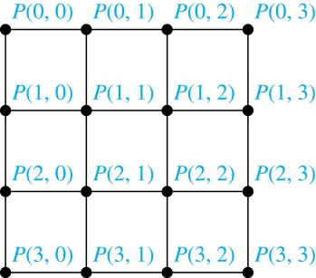
Special Types of Graphs and Computer Network Architecture
Various special graphs also play a role in parallel processing where processors need to be interconnected as one processor may need the output generated by another.
The n-dimensional hypercube, or n-cube, Qn, is a common way to connect processors in parallel, e.g., Intel Hypercube.
Another common method is the mesh network, illustrated here for 16 processors.

Slide 146
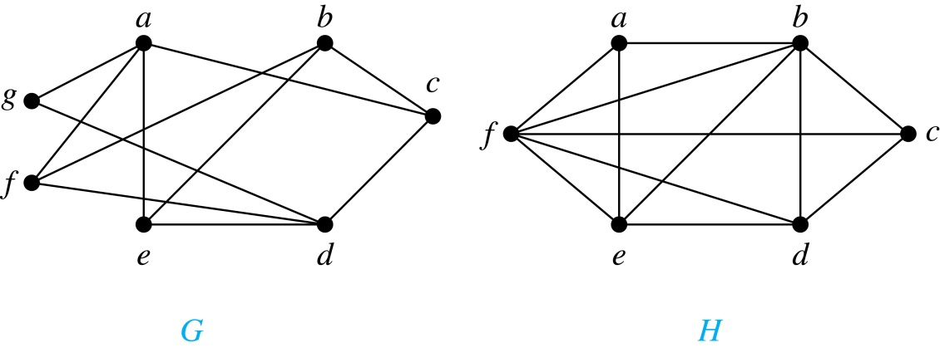
Bipartite Graphs
Definition: A simple graph G is bipartite if V can be partitioned into two disjoint subsets V₁ and V₂ such that every edge connects a vertex in V₁ and a vertex in V₂. In other words, there are no edges which connect two vertices in V₁ or in V₂.
It is not hard to show that an equivalent definition of a bipartite graph is a graph where it is possible to color the vertices red or blue so that no two adjacent vertices are the same color.
H is not bipartite since if we color a red, then the adjacent vertices f and b must both be blue.
G is bipartite

Slide 147
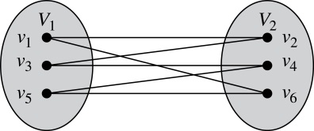
Bipartite Graphs (continued)
Example: Show that C₆ is bipartite.
Solution: We can partition the vertex set into
V₁ = {v₁, v₃, v₅} and V₂ = {v₂, v₄, v₆} so that every edge of C₆ connects a vertex in V₁ and V₂ .

Slide 148
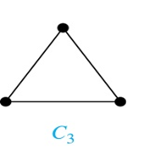
Bipartite Graphs (continued)
Example: Show that C₃ is not bipartite.
Solution: If we divide the vertex set of C₃ into two nonempty sets, one of the two must contain two vertices. But in C₃ every vertex is connected to every other vertex. Therefore, the two vertices in the same partition are connected. Hence, C₃ is not bipartite.

Slide 149
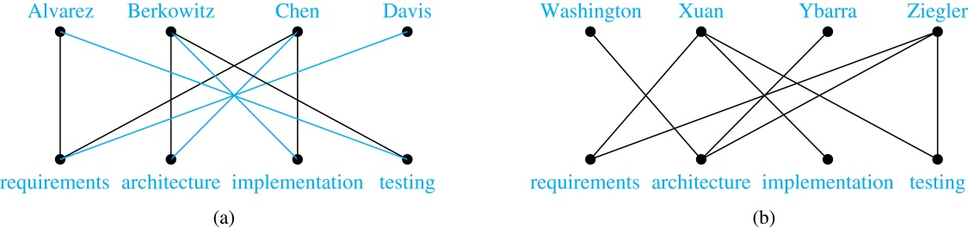
Bipartite Graphs and Matchings
Bipartite graphs are used to model applications that involve matching the elements of one set to elements in another, for example:
Job assignments - vertices represent the jobs and the employees, edges link employees with those jobs they have been trained to do. A common goal is to match jobs to employees so that the most jobs are done.

Slide 150

Complete Bipartite Graphs
Definition: A complete bipartite graph K_{m,n} is a graph that has its vertex set partitioned into two subsets V₁ of size m and V₂ of size n such that there is an edge from every vertex in V₁ to every vertex in V₂.
Example: We display four complete bipartite graphs here.

Slide 151

New Graphs from Old
Definition: A subgraph of a graph G = (V,E) is a graph (W,F), where W ⊂ V and F ⊂ E. A subgraph H of G is a proper subgraph of G if H ≠ G.
Example: Here we show K₅ and one of its subgraphs.
Definition: Let G = (V, E) be a simple graph. The subgraph induced by a subset W of the vertex set V is the graph (W,F), where the edge set F contains an edge in E if and only if both endpoints are in W.
Example: Here we show K₅ and the subgraph induced by W = {a,b,c,e}.

Slide 152

New Graphs from Old (continued)
Definition: The union of two simple graphs G₁ = (V₁, E₁) and G₂ = (V₂, E₂) is the simple graph with vertex set V₁ ⋃ V₂ and edge set E₁ ⋃ E₂. The union of G₁ and G₂ is denoted by G₁ ⋃ G₂.
Example:

Slide 153
Representing Graphs and Graph Isomorphism
Section 10.3

Slide 154
Section Summary
Adjacency Lists
Adjacency Matrices
Incidence Matrices
Isomorphism of Graphs

Slide 155


Representing Graphs: Adjacency Lists
Definition: An adjacency list can be used to represent a graph with no multiple edges by specifying the vertices that are adjacent to each vertex of the graph.
Example:

Slide 156


Representing Graphs: Adjacency Lists
Example:

Slide 157

Representation of Graphs: Adjacency Matrices
Definition: Suppose that G = (V, E) is a simple graph where |V| = n. Arbitrarily list the vertices of G as v₁, v₂, … , v_{n}. The adjacency matrix A_{G} of G, with respect to the listing of vertices, is the n × n zero-one matrix with 1 as its (i, j)th entry when v_{i} and v_{j} are adjacent, and 0 as its (i, j)th entry when they are not adjacent.
In other words, if the graphs adjacency matrix is A_{G} = [a_{ij}], then

Slide 158




Adjacency Matrices (continued)
Example:
When a graph is sparse, that is, it has few edges relatively to the total number of possible edges, it is much more efficient to represent the graph using an adjacency list than an adjacency matrix. But for a dense graph, which includes a high percentage of possible edges, an adjacency matrix is preferable.
The ordering
of vertices is a, b, c, d.
The ordering of vertices is a, b, c, d.
Note: The adjacency matrix of a simple graph is symmetric, i.e., a_{ij} = a_{ji}
Also, since there are no loops, each diagonal entry a_{ij} for i = 1, 2, 3, …, n, is 0.

Slide 159

Adjacency Matrices (continued)
Adjacency matrices can also be used to represent graphs with loops and multiple edges.
A loop at the vertex vi is represented by a 1 at the (i, j)th position of the matrix.
When multiple edges connect the same pair of vertices vi and vj, (or if multiple loops are present at the same vertex), the (i, j)th entry equals the number of edges connecting the pair of vertices.
Example: We give the adjacency matrix of the pseudograph shown here using the ordering of vertices a, b, c, d.

Slide 160
Adjacency Matrices (continued)
Adjacency matrices can also be used to represent directed graphs. The matrix for a directed graph G = (V, E) has a 1 in its (i, j)th position if there is an edge from v_{i} to v_{j}, where v₁, v₂, … v_{n} is a list of the vertices.
In other words, if the graphs adjacency matrix is A_{G} = [a_{ij}], then
The adjacency matrix for a directed graph does not have to be symmetric, because there may not be an edge from v_{i} to v_{j}, when there is an edge from v_{j} to v_{i}.
To represent directed multigraphs, the value of a_{ij} is the number of edges connecting v_{i} to v_{j}.

Slide 161

Representation of Graphs: Incidence Matrices
Definition: Let G = (V, E) be an undirected graph with vertices where v₁, v₂, … v_{n} and edges e₁, e₂, … e_{m}. The incidence matrix with respect to the ordering of V and E is the n × m matrix M = [m_{ij}], where

Slide 162




Incidence Matrices (continued)
Example: Simple Graph and Incidence Matrix
The rows going from top to bottom represent v₁ through v₅ and the columns going from left to right represent e₁ through e₆.
Example: Pseudograph and Incidence Matrix
The rows going from top to bottom represent v₁ through v₅ and the columns going from left to right represent e₁ through e₈.

Slide 163
Isomorphism of Graphs
Definition: The simple graphs G₁ = (V₁, E₁) and G₂ = (V₂, E₂) are isomorphic if there is a one-to-one and onto function f from V₁ to V₂ with the property that a and b are adjacent in G₁ if and only if f(a) and f(b) are adjacent in G₂ , for all a and b in V₁ . Such a function f is called an isomorphism. Two simple graphs that are not isomorphic are called nonisomorphic.

Slide 164
ISOMORPHIC INVARIANT
A property P is called an isomorphic invariant if, and only if, given any graphs G and G’,
If G has property P and G’ is isomorphic to G, then G’ has property P.
THEOREM OF ISOMORPHIC INVARIANT
Each of the following properties is an invariant for graph isomorphism, where n, m and k are all non-negative integers, if the graph:
1. has n vertices.
2. has m edges.
3. has a vertex of degree k.
4. has m vertices of degree k.
5. has a circuit of length k.
6. has a simple circuit of length k.
7. has m simple circuits of length k.
8. is connected.
9. has an Euler circuit.
10. has a Hamiltonian circuit.

Slide 165

Isomorphism of Graphs (cont.)
Example: Show that the graphs G =(V, E) and H = (W, F) are isomorphic.
Solution: The function f with
f(u₁) = v₁,f(u₂) = v₄, f(u₃) = v₃, and f(u₄) = v₂ is a one-to-one
correspondence between V and W.
Note that adjacent vertices in G are
u₁ and u₂, u₁ and u₃, u₂ and u₄,
and u₃ and u₄. Each of the pairs
f(u₁) = v₁ and f(u₂) = v₄, f(u₁) = v₁
and f(u₃) = v₃ , f(u₂) = v₄ and
f(u₄) = v₂ , and f(u₃) = v₃ and
f(u₄) = v₂ consists of two adjacent vertices in H.

Slide 166
Isomorphism of Graphs (cont.)
It is difficult to determine whether two simple graphs are isomorphic using brute force because there are n! possible one-to-one correspondences between the vertex sets of two simple graphs with n vertices.
The best algorithms for determining weather two graphs are isomorphic have exponential worst case complexity in terms of the number of vertices of the graphs.
Sometimes it is not hard to show that two graphs are not isomorphic. We can do so by finding a property, preserved by isomorphism, that only one of the two graphs has. Such a property is called graph invariant.
There are many different useful graph invariants that can be used to distinguish nonisomorphic graphs, such as the number of vertices, number of edges, and degree sequence (list of the degrees of the vertices in nonincreasing order). We will encounter others in later sections of this chapter.

Slide 167


Isomorphism of Graphs (cont.)
Example: Determine whether these two graphs are isomorphic.
Solution: Both graphs have eight vertices and ten edges.
They also both have four vertices of degree two and four of degree three.
However, G and H are not isomorphic. Note that since deg(a) = 2 in G, a must correspond to t, u, x, or y in H, because these are the vertices of degree 2. But each of these vertices is adjacent to another vertex of degree two in H, which is not true for a in G.
Alternatively, note that the subgraphs of G and H
made up of vertices of degree three and the edges
connecting them must be isomorphic.
But the subgraphs, as shown at the right,
are not isomorphic.

Slide 168

Isomorphism of Graphs (cont.)
Example: Determine whether these two graphs are isomorphic.
Solution: Both graphs have six vertices and seven edges.
They also both have four vertices of degree two and two of degree three.
The subgraphs of G and H consisting of all the vertices of degree two and the edges connecting them are isomorphic. So, it is reasonable to try to find an isomorphism f.
We define an injection f from the vertices of G to the vertices of H that preserves the degree of vertices. We will determine whether it is an isomorphism.
The function f with f(u₁) = v₆, f(u₂) = v₃, f(u₃) = v₄, and f(u₄) = v₅ , f(u₅) = v₁, and f(u₆) = v₂ is a one-to-one correspondence between G and H. Showing that this correspondence preserves edges is straightforward, so we will omit the details here. Because f is an isomorphism, it follows that G and H are isomorphic graphs.

Slide 169
Algorithms for Graph Isomorphism
The best algorithms known for determining whether two graphs are isomorphic have exponential worst-case time complexity (in the number of vertices of the graphs).
However, there are algorithms with linear average-case time complexity.
You can use a public domain program called NAUTY to determine in less than a second whether two graphs with as many as 100 vertices are isomoprhic.
Graph isomorphism is a problem of special interest because it is one of a few NP problems not known to be either tractable or NP-complete (see Section 3.3).

Slide 170
Applications of Graph Isomorphism
The question whether graphs are isomorphic plays an important role in applications of graph theory. For example,
chemists use molecular graphs to model chemical compounds. Vertices represent atoms and edges represent chemical bonds. When a new compound is synthesized, a database of molecular graphs is checked to determine whether the graph representing the new compound is isomorphic to the graph of a compound that this already known.
Electronic circuits are modeled as graphs in which the vertices represent components and the edges represent connections between them. Graph isomorphism is the basis for
the verification that a particular layout of a circuit corresponds to the design’s original schematics.
determining whether a chip from one vendor includes the intellectual property of another vendor.

Slide 171
Connectivity
Section 10.4

Slide 172
Section Summary
Paths
Connectedness in Undirected Graphs
Connectedness in Directed Graphs
Counting Paths between Vertices

Slide 173
Paths
Informal Definition: A path is a sequence of edges that begins at a vertex of a graph and travels from vertex to vertex along edges of the graph. As the path travels along its edges, it visits the vertices along this path, that is, the endpoints of these.
Applications: Numerous problems can be modeled with paths formed by traveling along edges of graphs such as:
determining whether a message can be sent between two computers.
efficiently planning routes for mail delivery.

Slide 174
Paths
Definition: Let n be a nonnegative integer and G an undirected graph. A path of length n from u to v in G is a sequence of n edges e₁, … , e_{n} of G for which there exists a sequence x₀ = u, x₁, …, x_{n-1}, x_{n} = v of vertices such that e_{i} has, for i = 1, …, n, the endpoints x_{i-1} and x_{i}.
When the graph is simple, we denote this path by its vertex sequence x₀, x₁, … , x_{n}(since listing the vertices uniquely determines the path).
The path is a circuit if it begins and ends at the same vertex (u = v) and has length greater than zero.
The path or circuit is said to pass through the vertices x₁, x₂, … , x_{n-1} and traverse the edges e₁, … , e_{n}.
A path or circuit is simple if it does not contain the same edge more than once.
This terminology is readily extended to directed graphs. (see text)

Slide 175

Paths (continued)
Example: In the simple graph here:
a, d, c, f, e is a simple path of length 4.
d, e, c, a is not a path because e is not connected to c.
b, c, f, e, b is a circuit of length 4.
a, b, e, d, a, b is a path of length 5, but it is not a simple path.

Slide 176

Connectedness in Undirected Graphs
Definition: An undirected graph is called connected if there is a path between every pair of vertices. An undirected graph that is not connected is called disconnected. We say that we disconnect a graph when we remove vertices or edges, or both, to produce a disconnected subgraph.
Example: G₁ is connected because there is a path between any pair of its vertices, as can be easily seen. However G₂ is not connected because there is no path between vertices a and f, for example.

Slide 177
Euler and Hamiltonian Graphs
Section 10.5

Slide 178
Section Summary
Euler Paths and Circuits
Hamilton Paths and Circuits
Applications of Hamilton Circuits

Slide 179



Euler Paths and Circuits
The town of Kӧnigsberg, Prussia
(now Kalingrad, Russia) was divided into
four sections by the branches of the Pregel river. In the 18th century seven bridges connected these regions.
People wondered whether whether it was possible to follow a path that crosses each bridge exactly once and returns to the starting point.
The Swiss mathematician Leonard Euler proved that no such path exists. This result is often considered to be the first theorem ever proved in graph theory.
Leonard Euler (1707-1783)
Multigraph Model of the Bridges of Kӧnigsberg
The 7 Bridges of Kӧnigsberg

Slide 180

Euler Paths and Circuits
Definition: An Euler circuit in a graph G is a simple circuit containing every edge of G. An Euler path in G is a simple path containing every edge of G.
Example: Which of the undirected graphs G₁, G₂, and G₃ has a Euler circuit? Of those that do not, which has an Euler path?
Solution: The graph G₁ has an Euler circuit (e.g., a, e, c, d, e, b, a). But, as can easily be verified by inspection, neither G₂ nor G₃ has an Euler circuit. Note that G₃ has an Euler path (e.g., a, c, d, e, b, d, a, b), but there is no Euler path in G₂, which can be verified by inspection.

Slide 181
Necessary Conditions for Euler Circuits and Paths
An Euler circuit begins with a vertex a and continues with an edge incident with a, say {a, b}. The edge {a, b} contributes one to deg(a).
Each time the circuit passes through a vertex it contributes two to the vertex’s degree.
Finally, the circuit terminates where it started, contributing one to deg(a). Therefore deg(a) must be even.
We conclude that the degree of every other vertex must also be even.
By the same reasoning, we see that the initial vertex and the final vertex of an Euler path have odd degree, while every other vertex has even degree. So, a graph with an Euler path has exactly two vertices of odd degree.
In the next slide we will show that these necessary conditions are also sufficient conditions.

Slide 182

Sufficient Conditions for Euler Circuits and Paths
Suppose that G is a connected multigraph with ≥ 2 vertices, all of even degree. Let x₀ = a be a vertex of even degree. Choose an edge {x₀, x₁} incident with a and proceed to build a simple path {x₀, x₁}, {x₁, x₂}, …, {x_{n-1}, x_{n}} by adding edges one by one until another edge can not be added.
The path begins at a with an edge of the
form {a, x}; we show that it must terminate
at a with an edge of the form {y, a}. Since each vertex has an even degree, there must be an even number of edges incident with this vertex. Hence, every time we enter a vertex other than a, we can leave it. Therefore, the path can only end at a.
If all of the edges have been used, an Euler circuit has been constructed. Otherwise, consider the subgraph H obtained from G by deleting the edges already used.
We illustrate this idea in the graph G here. We begin at a and choose the edges {a, f}, {f, c}, {c, b}, and {b, a} in succession.
In the example H consists of the vertices c, d, e.

Slide 183
Sufficient Conditions for Euler Circuits and Paths
Because G is connected, H must have at least one vertex in common with the circuit that has been deleted.
Every vertex in H must have even degree because all the vertices in G have even degree and for each vertex, pairs of edges incident with this vertex have been deleted. Beginning with the shared vertex construct a path ending in the same vertex (as was done before). Then splice this new circuit into the original circuit.
Continue this process until all edges have been used. This produces an Euler circuit. Since every edge is included and no edge is included more than once.
Similar reasoning can be used to show that a graph with exactly two vertices of odd degree must have an Euler path connecting these two vertices of odd degree
In the example, the vertex is c.
In the example, we end up with the circuit a, f, c, d, e, c, b, a.

Slide 184
Algorithm for Constructing an Euler Circuits
In our proof we developed this algorithms for constructing a Euler circuit in a graph with no vertices of odd degree.
procedure Euler(G: connected multigraph with all vertices of even degree)
circuit := a circuit in G beginning at an arbitrarily chosen vertex with edges
successively added to form a path that returns to this vertex.
H := G with the edges of this circuit removed
while H has edges
subciruit := a circuit in H beginning at a vertex in H that also is
an endpoint of an edge in circuit.
H := H with edges of subciruit and all isolated vertices removed
circuit := circuit with subcircuit inserted at the appropriate vertex.
return circuit{circuit is an Euler circuit}

Slide 185
Necessary and Sufficient Conditions for Euler Circuits and Paths (continued)
Theorem: A connected multigraph with at least two vertices has an Euler circuit if and only if each of its vertices has an even degree and it has an Euler path if and only if it has exactly two vertices of odd degree.
Example: Two of the vertices in the multigraph model of the Kӧnigsberg bridge problem have odd degree. Hence, there is no Euler circuit in this multigraph and it is impossible to start at a given point, cross each bridge exactly once, and return to the starting point.

Slide 186

Euler Circuits and Paths
Example:
G₁ contains exactly two vertices of odd degree (b and d). Hence it has an Euler path, e.g., d, a, b, c, d, b.
G₂ has exactly two vertices of odd degree (b and d). Hence it has an Euler path, e.g., b, a, g, f, e, d, c, g, b, c, f, d.
G₃ has six vertices of odd degree. Hence, it does not have an Euler path.

Slide 187
Applications of Euler Paths and Circuits
Euler paths and circuits can be used to solve many practical problems such as finding a path or circuit that traverses each
street in a neighborhood,
road in a transportation network,
connection in a utility grid,
link in a communications network.
Other applications are found in the
layout of circuits,
network multicasting,
molecular biology, where Euler paths are used in the sequencing of DNA.

Slide 188



Hamilton Paths and Circuits
William Rowan Hamilton (1805- 1865)
Euler paths and circuits contained every edge only once.
Now we look at paths and circuits that contain every vertex exactly once.
William Hamilton invented the Icosian puzzle in 1857. It consisted of a wooden dodecahedron (with 12 regular pentagons as faces), illustrated in (a), with a peg at each vertex, labeled with the names of different cities. String was used to used to plot a circuit visiting 20 cities exactly once
The graph form of the puzzle is given in (b).
The solution (a Hamilton circuit) is given here.

Slide 189
Hamilton Paths and Circuits
Definition: A simple path in a graph G that passes through every vertex exactly once is called a Hamilton path, and a simple circuit in a graph G that passes through every vertex exactly once is called a Hamilton circuit.
That is, a simple path x₀, x₁, …, x_{n-1}, x_{n} in the graph G = (V, E) is called a Hamilton path if V = {x₀, x₁, … , x_{n-1,} x_{n} } and x_{i} ≠ x_{j} for 0≤ i < j ≤ n, and the simple circuit x₀, x₁, …, x_{n-1}, x_{n}, x₀ (with n > 0) is a Hamilton circuit if x₀, x₁, … , x_{n-1}, x_{n} is a Hamilton path.

Slide 190
Hamilton Paths and Circuits (continued)
Example: Which of these simple graphs has a Hamilton circuit or, if not, a Hamilton path?
Solution: G₂ has a Hamilton circuit: a, b, c, d, e, a.
G₁ does not have a Hamilton circuit (Why?), but does have a Hamilton path : a, b ,e , c, d.
G₃ has a Hamilton circuit: a,b,e,d,c,a

Slide 191


Necessary Conditions for Hamilton Circuits
Gabriel Andrew Dirac
(1925-1984)
Unlike for an Euler circuit, no simple necessary and sufficient conditions are known for the existence of a Hamiton circuit.
However, there are some useful necessary conditions. We describe two of these now.
Dirac’s Theorem: If G is a simple graph with n ≥ 3 vertices such that the degree of every vertex in G is ≥ n/2, then G has a Hamilton circuit.
Ore’s Theorem: If G is a simple graph with n ≥ 3 vertices such that deg(u) + deg(v) ≥ n for every pair of nonadjacent vertices, then G has a Hamilton circuit.
Øysten Ore
(1899-1968)

Slide 192
Applications of Hamilton Paths and Circuits
Applications that ask for a path or a circuit that visits each intersection of a city, each place pipelines intersect in a utility grid, or each node in a communications network exactly once, can be solved by finding a Hamilton path in the appropriate graph.
The famous traveling salesperson problem (TSP) asks for the shortest route a traveling salesperson should take to visit a set of cities. This problem reduces to finding a Hamilton circuit such that the total sum of the weights of its edges is as small as possible.
A family of binary codes, known as Gray codes, which minimize the effect of transmission errors, correspond to Hamilton circuits in the n-cube Q_{n.}

Slide 193
Shortest Paths

Slide 194
Weighted Graphs
Graphs that have a number assigned to each edge are called weighted graphs.
BOS
CHI
NY
SF
DEN
ATL
LA
MIA

Slide 195
Weighted Graphs
MILES
BOS
2534
860
191
1855
722
NY
CHI
SF
DEN
908
957
606
760
349
834
2451
1090
ATL
LA
595
MIA

Slide 196
Weighted Graphs
FARES
BOS
$129
$79
$39
$99
$59
NY
CHI
SF
DEN
$69
$89
$79
$89
$99
$39
$129
ATL
LA
$69
MIA

Slide 197
Weighted Graphs
FLIGHT TIMES
BOS
4:05
2:10
0:50
2:55
NY
CHI
1:50
SF
DEN
2:10
2:20
1:55
1:40
1:15
2:00
3:50
2:45
ATL
LA
1:30
MIA

Slide 198
Weighted Graphs
A weighted graph is a graph in which each edge (u, v) has a weight w(u, v). Each weight is a real number.
Weights can represent distance, cost, time, capacity, etc.
The length of a path in a weighted graph is the sum of the weights on the edges.
Dijkstra’s Algorithm finds the shortest path between two vertices.

Slide 199


Slide 200
Dijkstra’s Algorithm
Dijkstra’s algorithm is used in problems relating to finding the shortest path.
Each node is given a temporary label denoting the length of the shortest path from the start node so far.
This label is replaced if another shorter route is found.
Once it is certain that no other shorter paths can be found, the temporary label becomes a permanent label.
Eventually all the nodes have permanent labels.
At this point the shortest path is found by retracing the path backwards.

Slide 201
Dijkstra’s algorithm: example
D(v)
p(v)
D(w)
p(w)
D(x)
p(x)
D(y)
p(y)
D(z)
p(z)
Step
N'
0
u
7,u
3,u
5,u
∞
∞
1
uw
6,w
5,u
11,w
∞
2
uwx
6,w
11,w
14,x
3
uwxv
10,v
14,x
4
uwxvy
12,y
5
uwxvyz
x
9
notes:
construct shortest path tree by tracing predecessor nodes
ties can exist (can be broken arbitrarily)
5
7
4
8
u
3
w
y
z
2
3
7
4
v

Slide 202
Dijkstra’s algorithm: another example
Step
0
1
2
3
4
5
N'
u
ux
uxy
uxyv
uxyvw
uxyvwz
D(v),p(v)
2,u
2,u
2,u
D(w),p(w)
5,u
4,x
3,y
3,y
D(x),p(x)
1,u
D(y),p(y)
∞
2,x
D(z),p(z)
∞
∞
4,y
4,y
4,y
5
v
3
w
2
5
u
2
1
z
3
1
2
x
y
1
* Check out the online interactive exercises for more examples: http://gaia.cs.umass.edu/kurose_ross/interactive/

Slide 203
Problem: shortest path from a to z
b
d
5
f
5
4
7
3
4
1
2
a
z
3
4
c
5
e
5
g

Slide 204
The Traveling Salesman Problem
The traveling salesman problem is one of the classical problems in computer science.
A traveling salesman wants to visit a number of cities and then return to his starting point. Of course he wants to save time and energy, so he wants to determine the shortest cycle for his trip.
We can represent the cities and the distances between them by a weighted, complete, undirected graph.
The problem then is to find the shortest cycle (of minimum total weight that visits each vertex exactly one).
Finding the shortest cycle is different than Dijkstra’s shortest path. It is much harder too, no polynomial time algorithm exists!

Slide 205
The Traveling Salesman Problem
Importance:
Variety of scheduling application can be solved as a traveling salesmen problem.
Examples:
Ordering drill position on a drill press.
School bus routing.
The problem has theoretical importance because it represents a class of difficult problems known as NP-hard problems.

Slide 206

Travelling Salesman problem

Slide 207

Travelling Salesman problem

Slide 208
Trees
Chapter 11

Slide 209
Chapter Summary
Introduction to Trees
Applications of Trees
Tree Traversal
Spanning Trees
Minimum Spanning

Slide 210
Introduction to Trees
Section 11.1

Slide 211
Section Summary
Introduction to Trees
Rooted Trees
Trees as Models
Properties of Trees

Slide 212
Trees
Definition: A tree is a connected undirected graph with no simple circuits.
Definition: An undirected graph is a tree if and only if there is a unique simple path between any two of its vertices. A tree cannot contain multiple edges or loops.
Definition: An undirected graph is a tree if and only if there is a unique simple path between any two of its vertices.

Slide 213

Trees
Example: Which of these graphs are trees?
Solution: G₁ and G₂ are trees - both are connected and have no simple circuits. G₃ is not a tree because e, b, a, d, e is a simple circuit,. G₄ is not a tree because it is not connected.

Slide 214

FOREST
Definition: A forest is a graph that has no simple circuit, but is not connected. Each of the connected components in a forest is a tree.

Slide 215


Trees as Models
Arthur Cayley
(1821-1895)
Trees are used as models in computer science, chemistry, geology, botany, psychology, and many other areas.
Trees were introduced by the mathematician Cayley in 1857 in his work counting the number of isomers of saturated hydrocarbons. The two isomers of butane are:.

Slide 216

Trees as Models
The organization of a computer file system into directories, subdirectories, and files is naturally represented as a tree.

Slide 217

Trees as Models
Trees are used to represent the structure of organizations.

Slide 218

Rooted Trees
Definition: A rooted tree is a tree in which one vertex has been designated as the root and every edge is directed away from the root.
An unrooted tree is converted into different rooted trees when different vertices are chosen as the root.

Slide 219

Rooted Tree Terminology
Terminology for rooted trees is a mix from botany and genealogy (such as this family tree of the Bernoulli family of mathematicians).

Slide 220
Rooted Tree Terminology
If v is a vertex of a rooted tree other than the root, the parent of v is the unique vertex u such that there is a directed edge from u to v. When u is a parent of v, v is called a child of u. Vertices with the same parent are called siblings.
The ancestors of a vertex are the vertices in the path from the root to this vertex, excluding the vertex itself and including the root. The descendants of a vertex v are those vertices that have v as an ancestor.
A vertex of a rooted tree with no children is called a leaf. Vertices that have children are called internal vertices.
If a is a vertex in a tree, the subtree with a as its root is the subgraph of the tree consisting of a and its descendants and all edges incident to these descendants.

Slide 221

Terminology for Rooted Trees
Example: In the rooted tree T (with root a):
Find the parent of c, the children of g, the siblings of h, the ancestors of e, and the descendants of b.
Solution:
The parent of c is b. The children of g are h, i, and j. The siblings of h are i and j. The ancestors of e are c, b, and a. The descendants of b are c, d, and e.

Slide 222
Terminology for Rooted Trees
Example: In the rooted tree T (with root a):
Find all internal vertices and all leaves.
Solution:
The internal vertices are a, b, c, g, h, and j. The leaves are d, e, f, i, k, l, and m.

Slide 223

Terminology for Rooted Trees
What is the subtree rooted at G?
Solution:
We display the subtree rooted at g.

Slide 224

m-ary Rooted Trees
Definition: A rooted tree is called an m-ary tree if every internal vertex has no more than m children. The tree is called a full m-ary tree if every internal vertex has exactly m children. An m-ary tree with m = 2 is called a binary tree.
Example: Are the following rooted trees full m-ary trees for some positive integer m?

Slide 225
Solution:
T₁ is a full binary tree because each of its internal vertices has two children.
T₂ is a full 3-ary tree because each of its internal vertices has three children.
In T₃ each internal vertex has five children, so T₃ is a full 5-ary tree.
T₄ is not a full m-ary tree for any m because some of its internal vertices have two children and others have three children.

Slide 226

Ordered Rooted Trees
Definition: An ordered rooted tree is a rooted tree where the children of each internal vertex are ordered.
We draw ordered rooted trees so that the children of each internal vertex are shown in order from left to right.

Slide 227
Binary Trees
Definition: A binary tree is an ordered rooted where where each internal vertex has at most two children. If an internal vertex of a binary tree has two children, the first is called the left child and the second the right child. The tree rooted at the left child of a vertex is called the left subtree of this vertex, and the tree rooted at the right child of a vertex is called the right subtree of this vertex.

Slide 228

Example:
Consider the binary tree T.
(i) What are the left and right children of d?
(ii) What are the left and right subtrees of c?
Solution:
(i) The left child of d is f and the right child is g.
(ii) The left and right subtrees of c are displayed in (b) and (c).

Slide 229
Properties of Trees
A tree with n vertices has n − 1 edges.
A full m-ary tree with i internal vertices has n = mi + 1 vertices.
A full m-ary tree with:
n vertices has i = (n − 1)/m internal vertices and l = [(m − 1)n + 1]/m leaves,
(ii) i internal vertices has n = mi + 1 vertices and
l = (m − 1)i + 1 leaves,
(iii) l leaves has n = (ml − 1)/(m − 1) vertices and
i = (l − 1)/ (m − 1) internal vertices.
There are at most $$m^{h}$$ leaves in an m-ary tree of height h.

Slide 230
Level of vertices and height of trees
When working with trees, we often want to have rooted trees where the subtrees at each vertex contain paths of approximately the same length.
To make this idea precise we need some definitions:
The level of a vertex v in a rooted tree is the length of the unique path from the root to this vertex.
The height of a rooted tree is the maximum of the levels of the vertices.

Slide 231

Level of vertices and height of trees
Example:
(i) Find the level of each vertex in
the tree to the right.
(ii) What is the height of the tree?
Solution:
(i) The root a is at level 0.
Vertices b, j, and k are at level 1.
Vertices c, e, f, and l are at level 2.
Vertices d, g, i, m, and n are at level 3.
Vertex h is at level 4.
(ii) The height is 4, since 4 is the largest level of any vertex.

Slide 232

Balanced m-Ary Trees
Definition: A rooted m-ary tree of height h is balanced if all leaves are at levels h or h − 1.
Example: Which of the rooted trees shown below is balanced?
Solution: T₁ and T₃ are balanced, but T₂ is not because it has leaves at levels 2, 3, and 4.

Slide 233
Applications of Trees
Section 11.2

Slide 234
Binary Search Tree
Definition: A binary tree in which the vertices are labeled with items so that a label of a vertex is greater than the labels of all vertices in the left subtree of this vertex and is less than the labels of all vertices in the right subtree of this vertex.
Searching for items in a list is one of the most important tasks that arises in computer science.
Our primary goal is to implement a searching algorithm that finds items efficiently when the items are totally ordered. This can be accomplished through the use of a binary search tree

Slide 235

Example : Form a binary search tree for the words mathematics, physics, geography, zoology, meteorology, geology, psychology, and chemistry (using alphabetical order).

Slide 236
Decision Trees
Definition: A rooted tree where each vertex represents a possible outcome of a decision and the leaves represent the possible solutions of a problem.
Rooted trees can be used to model problems in which a series of decisions leads to a solution.
The possible solutions of the problem correspond to the paths to the leaves of this rooted tree.

Slide 237

Example : A decision tree that orders the elements of the list a, b, c.

Slide 238

Prefix code
Definition: A code that has the property that the code of a character is never a prefix of the code of another character.
A prefix code can be represented using a binary tree, where the characters are the labels of the leaves in the tree.
The edges of the tree are labeled so that an edge leading to a left child is assigned a 0 and an edge leading to a right child is assigned a 1.
The bit string used to encode a character is the sequence of labels of the edges in the unique path from the root to the leaf that has this character as its label.
For instance, the tree in Figure 5 represents the encoding of e by 0, a by 10, t by 110, n by 1110, and s by 1111.

Slide 239
Applications of Trees
Game Trees
Trees can be used to analyze certain types of games such as tic-tac-toe, nim, checkers, and chess.

Slide 240

Game Tree for Tic-Tac-Toe

Slide 241

Universal Address Systems

Slide 242
Spanning Trees
Section 11.4

Slide 243
Section Summary
Spanning Trees
Depth-First Search
Breadth-First Search
Backtracking Applications
Depth-First Search in Directed Graphs

Slide 244

Spanning Trees
Definition: Let G be a simple graph. A spanning tree of G is a subgraph of G that is a tree containing every vertex of G.
Example: Find the spanning tree of the simple graph:

Slide 245

Spanning Trees
Solution: The graph is connected, but is not a tree because it contains simple circuits. Remove the edge {a, e}. Now one simple circuit is gone, but the remaining subgraph still has a simple circuit. Remove the edge {e, f} and then the edge {c, g} to produce a simple graph with no simple circuits. It is a spanning tree, because it contains every vertex of the original graph.

Slide 246
Minimum Spanning
Section 11.5

Slide 247
Minimum spanning tree
A minimum spanning tree in a connected weighted graph is a spanning tree that has the smallest possible sum of weights of its edges.
Example: A company plans to build a communications network connecting its five computer centers. Any pair of these centers can be linked with a leased telephone line. Which links should be made to ensure that there is a path between any two computer centers so that the total cost of the network is minimized?

Slide 248

Minimum spanning tree
Solution: We can model this problem using the weighted graph shown in Figure 1, where vertices represent computer centers, edges represent possible leased lines, and the weights on edges are the monthly lease rates of the lines represented by the edges. We can solve this problem by finding a spanning tree so that the sum of the weights of the edges of the tree is minimized. Such a spanning tree is called a minimum spanning tree.

Slide 249

KRUSKAL’S ALGORITHM

Slide 250

PRIM’S ALGORITHM

Slide 251

Minimal spanning tree (MST)
Example: Use Kruskal’s and Prims algorithm to find a minimal spanning tree for the graph below. Indicate the order in which edges are added to form the tree.

Slide 252

SOLUTION:

